Slide 1
Main Components
Rotor
Nacelle
Tower
Foundation

Slide 2
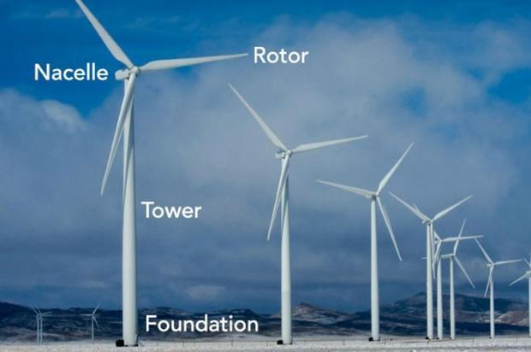

Slide 3
Rotor
Generates Aerodynamic Torque from the Wind
The rotor converts the energy contained in the wind in rotational movement so as bigger the area, bigger power output in the same wind conditions.
Consists of: Hub Blades Spinner Pitch bearing and system

Slide 4
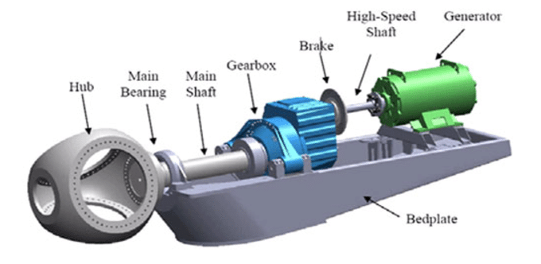
Nacelle with drivetrain and power electronics

Slide 5
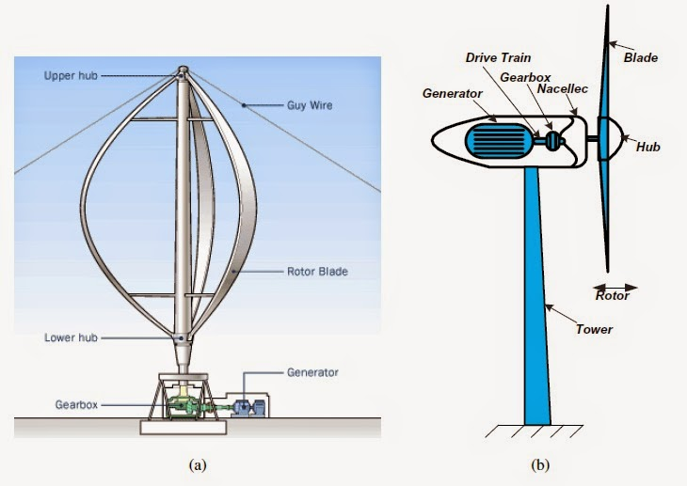

Slide 6
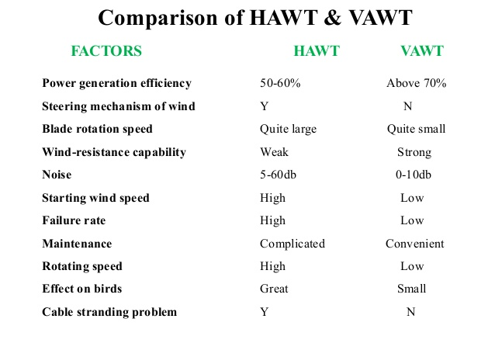

Slide 7
Vertical Axis Wind Turbine Aerodynamic Analysis

Slide 8
The wind turbine parameters considered in the design process are:
• Swept area
• Power and power coefficient
• Tip speed ratio
• Blade chord
• Number of blades
• Solidity
• Initial angle of attack

Slide 9
Swept area
The swept area is the section of air that encloses the turbine in its movement
The swept area limits the volume of air passing by the turbine.
the shape of the swept area depends on the rotor configuration where for HAWT is circular shaped while for VAWT is Rectangular shaped.
Swept Area calculated using: S=2RL where: S is the swept area [m2] R is the rotor radius [m] L is the blade length [m].

Slide 10
Power and power coefficient
The power available from wind for a vertical axis wind turbine can be found from the following formula: P_{w} = ½ S ρ V_{o}³ where: Vo is the velocity of the wind [m/s] ρ is the air density [kg/m3 ], the reference density used its standard sea level value (1.225 kg/m^3 at 15ºC), for other values from the source (Aerospaceweb.org, 2005).

Slide 11
The power the turbine takes from wind is calculated using the power coefficient:
C_{p} = $\frac{Captured mechanical power by blades}{Available wind power}$
This power coefficient only considers the mechanical energy converted directly from wind energy; it does not consider the mechanical-into-electrical energy conversion
The value of maximum power coefficient ranges usually between 0.15 and 0.22.
theoretical limit in the efficiency, Lanchester-Betz limit:
For HAWT, the limit is 19/27 (59.3%) For VAWT, the limit is 16/25 (64%)

Slide 12
Tip Speed Ratio
It is the ratio between the tangential speed at blade tip and the actual wind speed.
TSR = $\frac{Tangential Speed at the blade tip}{Actual wind speed}= \frac{R w}{\text{V}\text{o}}$
Where: ω is the angular speed [rad/s] R the rotor radius [m] V_{o} the ambient wind speed [m/s]
Each rotor design has an optimal tip speed ratio at which the maximum power extraction is achieved.

Slide 13
Blade chord
The chord is the length between leading edge and trailing edge of the blade profile. The blade thickness and shape is determined by the airfoil used, in this case it will be a NACA airfoil, where the blade curvature and maximum thickness are defined as percentage of the chord.

Slide 14
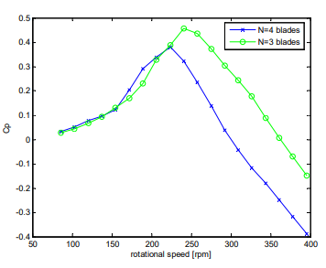
Number of blades
three blades are more efficient than four for the same rotational speed; the final decision will be made considering the acceleration behavior, which will provide a better view of the self-starting characteristics.

Slide 15
Solidity
The solidity σ is defined as the ratio between the total blade area and the projected turbine area. It is an important non-dimensional parameter which affects self-starting capabilities and for straight bladed VAWTs is calculated with
σ = $\frac{N c}{\text{R}}$
where
N is the number of blades c is the blade chord R is the Rotor radius
This formula is not applicable for HAWT as they have different shape of swept area.
Solidity determines when the assumptions of the momentum models are applicable, and only when using high σ ≥ 0.4 a self starting turbine is achieved

Slide 16
Initial angle of attack
The initial angle of attack for our design will be set at 0 degrees as the advantages of a different angle of attack are, according to this model, only evident at higher tip speed ratios than the intended for the model.
α = $\frac{\cos{θ . \cos{{\text{α}}_{o} − \left(X − \sin{θ}\right)\sin{{\text{α}}_{o}}}}}{\sqrt{{[(TSR − \sin^{2}{θ})}^{2} +(\cos^{2}{θ})]}}$ where α is the angle of attack which is defined as the angle between the blade chord and the resultant air velocity vector.

Slide 17
In order to speed up the optimization process, some of the parameters have to be fixed for our purposes. The fixed parameters will be the design airspeed and the blade swept area.
Since Power Coefficient C_{p} is between 0.15 and 0.2, so Swept area is between 4 and 5.2 m² to get 100 W at 6 m/s.
Swept area selected is 4 m²
Design air speed is kept at 6 m/s, as the purpose is to take profit of average wind speed rather than higher speeds.

Slide 18
The starting parameters and conditions in which the wind turbine has been tested are
Symbols | Parameter | Starting Value
V_{o} | Air speed | 6 m/s
TSR | Tip speed Ratio | 2
R | Rotor Radius | 1 m
c | Blade chord | 0.3 m
L | Blade length | 2 m
n | Number of Blades | 4
α_{o} | Initial angle of attack | 0⁰

Slide 19
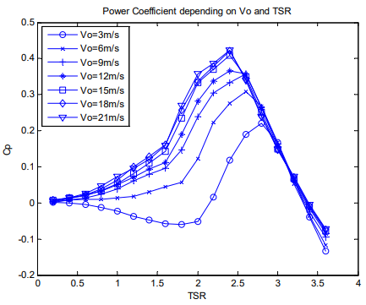

Slide 20
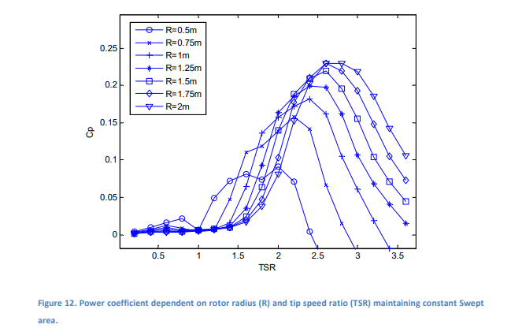

Slide 21
Princibles of wind power

Slide 25
Some important graphs

Slide 26
Some important graphs

Slide 27
Optimization of selecting aerofoil

Slide 28
Types of aerofoil used in HAWT
BLADE LENGTH (meter) | Generator size (KW) | THICKNESS CATEGORY | (root -------- | AIRFOIL ---------------- | FAMILY ----------------- | ------tip)
1-5 | 2-20 | thick |  | S823 |  | S822
5-10 | 20-150 | thin |  | S804 | S801 | S803
5-10 | 20-150 | thin | S808 | S807 | S805A | S806A
5-10 | 20-150 | thick |  | S821 | S819 | S820
10-15 | 150-400 | thick | S815 | S814 | S809 | S810
10-15 | 150-400 | thick | S815 | S814 | S812 | S813
15-25 | 400-1000 | thick |  | S818 | S816 | S817

Slide 29
NREL aerofoils National Renewable Energy Laboratory

Slide 30
Blades 1 to 5 Meters in Length One airfoil family, which consists of a root airfoil (S823) and tip airfoil (S822), was designed in 1993 for small turbines rated at 2-20 kW. The design specifications for this family indicate a tip region Cl of 1. 0 and a minimum drag Cd,min of 0. 010 for a Reynolds number of 600,000. The very
low Reynolds number range for this family contnoutes to a higher cd,min and increased difficulty in achieving a high root airfoil Cl max (1.2) for a Reynolds number of 400,000. This airfoil family is
suitable for many small variable-rpm machines such as the Jacobs 17.5 kW machine.

Slide 32
Energy extraction
The energy extraction is maintained in a flow process through the reduction of kinetic energy and subsequent velocity of the wind
The magnitude of energy harnessed is a function of the reduction in air speed over the turbine
100% extraction would imply zero final velocity and therefore zero flow,and this scenario can’t be achieved hence all the wind kinetic energy may not be utilized

Slide 33
Blades efficiency

Slide 34
Betz limit theory says that max. efficiency of a wind turbine is 59.3%
Betz theory assumption is that the flow is constant and linear
High ratio of Cl/Cd means higher power coefficient and high efficiency
Efficiency losses are generally reduced by:
-avoiding low tip speed ratios which increase wake rotation
-selecting an airfoils which have a high lift to drag ratio

Slide 36
Some important geometry factors affecting the design
NO.of blades
Blade shape
The more NO. OF BLADES ,The more the efficiency and the more the cost
From 2 blades to 3 blades the efficiency increases 3%
From 3 blades to 4 blades the efficiency increases only 0.5%
We have a challenge that we want a thinner blades V.S blades with good structural strength

Slide 37
Blade length
TOWER height
Power =0.5*efficiency*Rho*A*V^3
The proplems are:
-over deflection for blade
-proplem of noise
-heavy investment
The more the altitude”hight”,the more the speed of wind and the more the power gained

Slide 38
Flow chart of simulation

Slide 43
Wind resources
Wind resources are calculated based on the average wind speed and the distribution of wind speed values occurring within a particular area. Areas are grouped into wind power classes that range from 1 to 7. A wind power class of 3 or above (equivalent to a wind power density of 150–200 watts per square metre, or a mean wind of 5.1–5.6 metres per second [11.4–12.5 miles per hour]) is suitable for utility-scale wind power generation, although some suitable sites may also be found in areas of classes 1 and 2
put the cost of wind energy as low as 2–6 cents per kilowatt-hour, depending on the location. This is comparable to the cost of coal, natural gas, and other forms of fossil energy, which ranges between 5 and 17 cents per kilowatt-hour.

Slide 44
AIRFOILS AND BLADE GEOMETRY
In order to select a main blade to conduct the most extensive part of the optimization,random winglet configurations are taken from the design parameters range table. A blade is selected to perform more extensive optimization experiments after implementing a winglet. Selecting a single blade avoids having to implement the winglet in three different blades, reducing the experiment time outrageously. There are many different types of airfoils used for wind turbine rotor blades. Some researchers have used blended wings using two different types of airfoils in order to achieve the desired design. Such a design is shown in Figure 1.

Slide 46
As it can be observed, the NACA series airfoils are quite popular in this type of application. However, it has been shown that these airfoils have noticeable performance degradation from roughness effects resulting from leading-edge contamination. This leads to energy losses which can be of great importance for stall-regulated rotors. The National Renewable Energy Laboratory (NREL) began its development of new airfoils specific for wind turbine application. The annual energy improvements from the NREL airfoil families are worked to be 23% to 35% for stall-regulated turbines, 8% to 20% for variable-pitch turbines and 8% to 10% for variable-rpm turbines.

Slide 47
DESIGN OF WINGLET DESIGN
The geometry of a winglet is defined by six parameters
• Height
• Sweep angle
• Cant angle
• Curvature radius
• Toe angle
• Twist angle

Slide 48
The geometry of winglets has been extensively investigated for the aeronautical industry and specifically for high performance sailplanes. Since it has been shown that winglets decrease drag and improve aerodynamic performance of wind turbine rotor blades, it is important to understand and analyze the design and performance improvement process that these researchers used for this application. This gives a good overview and provides with ideas on how to manage the design process for the wind turbine application.

Slide 49
These geometric parameters can serve as the variables for input to the optimization algorithm in order to find the optimal shape given the aerodynamic constraints and goals.

Slide 50
THEORETICAL DESIGN BLADE PITCH ANGLE
A critical part of the rotor design includes the selection of either a variable speed ratio or a fixed speed ratio, and this is determined by either implementing a variable blade pitch system or selecting a fixed blade pitch angle. For the purpose of this work, a fixed blade pitch angle is chosen. Recalling previous definitions, the tip speed ratio is defined as the ratio between the blade tip speed and the wind speed. Since the wind speed in a regular environment is a variable phenomenon, it is physically right to say that having a fixed blade pitch angle produces a variable tip speed ratio. An optimal blade pitch angle is attained by means of BEM and later optimized through CFD.

Slide 51
BLADE TWIST ANGLE
A variable angle of attack through the length of the blade is given by a specified twist angle. The distribution of the twist angle is based on the aerodynamic behavior (Cd/Cl and other parameters) of each individual airfoil at a certain angle of attack. This angle of attack is then translated to the angle of relative wind by adding the initial twist angle of the blade. Equation yields to the angle of relative wind φ.
Where
λr is the local speed ratio
φ is the blade twist angle.

Slide 52
CHORD DISTRIBUTION
The chord length of each airfoil in a blade is also variable, and it is obtained with Equation
Where
B is the number of blades
The distribution of the chord length is given in the proposed design.

Slide 53
PROPOSED INITIAL DESIGN
The design of the blade has been preliminarily performed using Q-blade, available wind turbine blade design software which works together with X-foil in order to design and analyze a blade with different airfoils for each cross section as well as twist angle along the length of the blade.The parameters for the design of the blade were taken from a student design optimization in which a wind turbine blade was optimized using several methodologies including design of experiments (DOE), gradient-based sequential quadratic programming optimization and a multi objective genetic algorithm. The objective functions of this optimization work are to maximize the power output while minimizing the blade volume and structural stress. The chosen blade radius is 1.6 m, and in the airfoil used is 63 series especially 63-215, 63-215 (Modified), 63 - 415.

Slide 54
Given that the purpose of this work is the design of airfoil and winglets, the blade design will be based upon the findings of this real time work. In order to have an original blade design for this work, the following NACA airfoil family was used for the blade geometry. Table 2 shows the configuration for a medium to large blade length recommended by NACA. Unlike typical airfoils used in aeronautics, these airfoils have been specifically designed for wind turbines. The camber in these airfoils is higher than others, it can be observed that the thickness of the blade is higher at its root, and decreases along its length, until the thinnest airfoil is used at the tip.

Slide 55
The location of the airfoil family along the length of the blade is described in Table 2, where x is the position from the root to the tip of the blade and R is the radius of the blade (1.6 m).
The twist angle, defined as the angle between the airfoil chord length and the plane of the blade rotation, is shown in Table 3. Also, another parameter that is detailed in this table is the chord length of the airfoil. It can be observed that the chore length decreases along the length of the blade. This design technique is called tapering.

Slide 56
The design is given as a list of X, Y and Z coordinates of the section airfoil at each x/R. This enables the user to import each cross section as a curve in a CAD program, a spline is used to connect the point cloud and the part can be created by means of a blend option, such as in Pro Engineer.

Slide 60
Final Design With Winglet
SIZING AND PARAMETERS There are several sizing aspects involved in the design of a wind turbine, specifically a wind turbine blade. Based on previous designs and research, an optimal blade design has been used in this work, involving airfoils, twisting, setup, and scaling factors. The rotor diameter for the wind turbine is 3.0 meters, and the winglet configuration selected will add approximately 0.2 meter to this dimension, depending on the configuration used. This dimension could be altered by changes in one or more characteristics of the winglet. The design parameters of the winglet that this work involves are height, radius and cant angle.
CANT ANGLE The cant angle of a winglet has been previously defined in this report. The range of variation for the cant angle for the purpose of this work is from 10° to 90°.

Slide 61
RADIUS (Percentage of Height) The radius between the turbine blade and the winglet varies as a function of the winglet height; therefore the parameter setup for this case is a multiple of the height. The radius varies from 10% to 100% of the height of the winglet,.
HEIGHT The height of the winglet fluctuates in relation with the turbine rotor radius, varying from 1% to 2% of the rotor radius. This parameter is setup to change in the range of 0.16 to 0.32 meters.

Slide 63
Bionic aerofoils
the function of birds’ wings is very similar to that of wind turbine blades
The bionic research finds that the airfoils inspired by birds, including the seagull airfoil and those based on the leading edge of Long-eared Owl wings, have better aerodynamic performance
In this work, a new airfoil of the wind turbine blades was designed and used in the wind turbine blades. The efficiency of the wind turbine blades was carried out, and it was investigated how the new airfoil influences the performance of blades by aerodynamics numerical simulation.

Slide 64
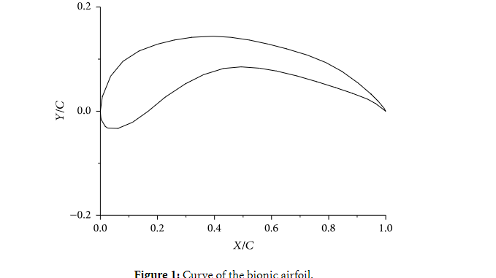
Bionic Airfoil Extraction
The point cloud data of the airfoils were collected using a 3D scanning system (Rexcan III, Solutionix Corp., Korea) with a scanning accuracy of 0.001 mm. The wing of the Long-eared Owl was unfolded naturally before the experiment. The scanned data were processed in IMAGEWARE 12, and the airfoil with superior aerodynamic performance was named as “bionic airfoil,” which is located at the point with a span-wise aspect ratio of 50% on the wings
As in figure1

Slide 65
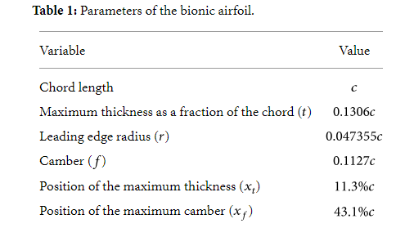
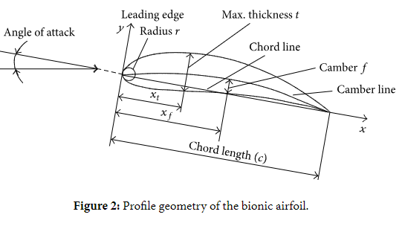
The profile geometry of the bionic airfoil is shown in Figure 2, the chord length is c , and the geometry parameters are shown in Table 1

Slide 66
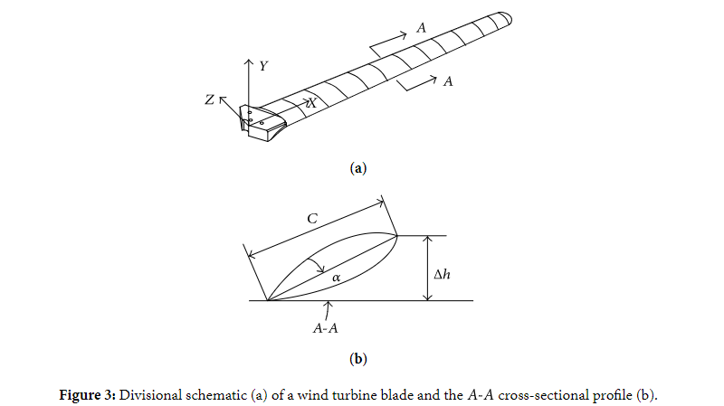
Blade Design:
Standard Blade Reconstruction
NACA4412 is one of the most common airfoils used for wind turbine blades due to its superior aerodynamic characteristics. A 500 Watt wind turbine blade of the NACA4412 airfoil was selected as “standard blade.” The length of the blade is 1200 mm, the blade root is from 0 mm to 130 mm and the blade span is from 130 mm to 1200 mm along the x -axis. In particular, the blade span of the standard blade is divided into 12 equal sections (see Figure 3), and the height of the section A-A is delta h .The airfoil shape of every section was obtained using the scanner, and the angle of attack (AOA) alpha=arcsin((delta h)/c) was calculated after measuring the chord length c.

Slide 67
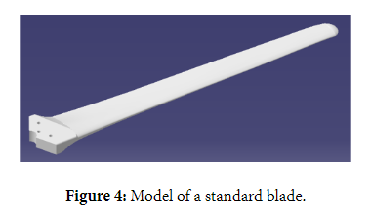
Airfoil at each section was established using CATIA V5R19. The aerodynamic center lies exactly at the one-quarter position of the chord. The blade was constructed by rotating the airfoils around the aerodynamic center according to the AOA, as shown in Figure 4.

Slide 68
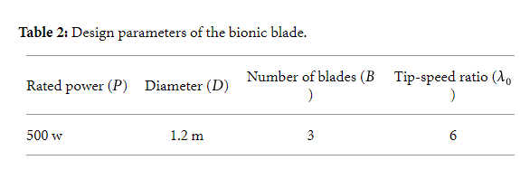
Bionic Blade Design
Because the characteristics of the airfoils used over the tip region of the blades have an important impact on the efficiency of the wind turbine, the airfoils of the chord positions after 60% were designed using the bionic airfoils. The design parameters of the bionic blade are shown in Table 2.
The lift-to-drag ratio of the airfoil reached its maximum at the span-wise aspect ratio of 50%, when the AOA was set at 3°, which in turn was used for the blade design. The blade incidences (theta) of different span-wise positions were calculated according to the Glauert theory, and the bionic blade and standard blade should have the same chord length to make sure that they have the same solidity.

Slide 69
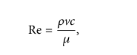
Numerical Simulations on Aerodynamics of the Airfoils
In ANSYS14.5, CEM-CFD was used to divide grid and FLUENT was used to carry out the numerical simulations for the standard airfoil (NACA4412 airfoil) and the bionic airfoils. Reynolds number is defined as follows:
where Re is Reynolds number, v is the mean velocity of the object relative to the fluid (27 m/s), c is the chord length (3 × 10⁻² m to 4.5 × 10⁻² m), rho is the density of the fluid (1.225 kg/m³), and meo is the dynamic viscosity of the fluid (1.789 × 10⁻⁵ kg/m·s). According to the (1), the range of Reynolds number is between 5.55 × 10⁴ and 8.32 × 10⁴. In our numerical simulation, Reynolds numbers (Re) were 6 × 10⁴ and 8 × 10⁴.
The large eddy simulation method was adopted for the numerical simulations. The computed field is shown in Figure 6. The airfoil chord length is c. The left field is a semicircle with a radius of 12.5*c , and the right part is a rectangle with a height 20*c of and a width of 25*c. When Mach Number (Ma) is less than 0.3, the air is considered as incompressible flow. Therefore, the inlet and outlet were set to “velocity inlet” and “pressure outlet,” respectively. The meshes generated were C-type meshes, as shown in Figure 7(a). The local mesh refinement was implemented at the leading edge and trailing edge of the airfoil, as shown in Figure 7(b).

Slide 70
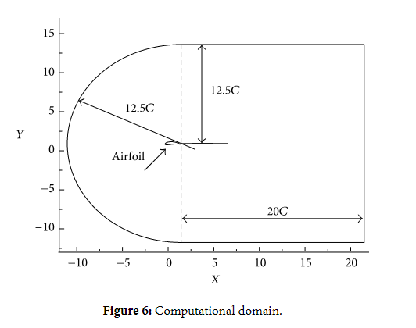
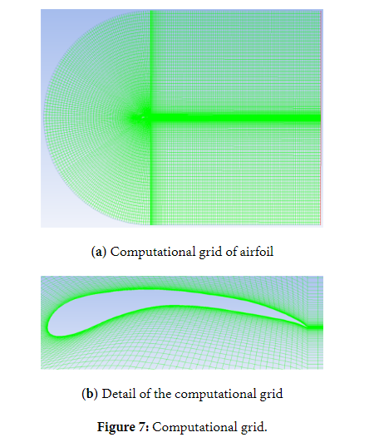

Slide 71
Average wind speed in egypt
This section discusses the wide-area hourly average wind vector (speed and direction) at 10 meters above the ground
The windier part of the year lasts for 4.5 months, from March 7 to July 25, with average wind speeds of more than 9.0 miles per hour. The windiest day of the year is June 10, with an average hourly wind speed of 10.1 miles per hour.
The calmer time of year lasts for 7.5 months, from July 25 to March 7. The calmest day of the year is January 5, with an average hourly wind speed of 7.9 miles per hour.

Slide 72
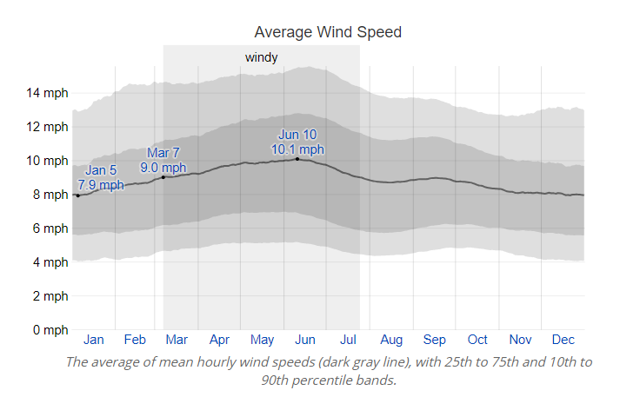

Slide 73
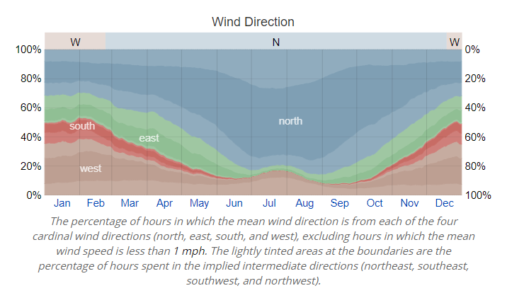
The wind is most often from the north for 9.8 months, from February 23 to December 18, with a peak percentage of 86% on August 28. The wind is most often from the west for 2.2 months, from December 18 to February 23, with a peak percentage of 35% on January 1.

Slide 75
Selection of blades material
A material is that out of which anything is or may be made. Much number of factors are affecting for the
material selection. They are properties of materials, performance requirements, material’s reliability, safety,
Physical attributes environmental conditions, availability, disposability and recyclability, and finally
economic factors. In these properties,
1) One of the most important factors affecting selection of materials for engineering design is the properties of the materials. The important properties of the materials are mechanical, thermal,chemical properties..,etc.

Slide 76
2) The material of which a part is composed must be capable of performing a part’s function (always
it must be possible or not) with out failure.
3) A material in a given application must also be reliable.
4) A material must safely perform its function.
5) Physical attributes such as configuration, size, weight, and appearance sometimes also serve
functional requirements can be used.
6) The environment in which a product operates strongly influences service performance.
7) A material must be readily available, and available in large enough quantity, for the intended
application.
8) The cost of the materials and the cost of processing the materials into the product or part. The
development and manufacture of satisfactory products at minimum cost is to make a sound,
economic choice of materials.
The material selection process involves the following major operations:
• Analysis of the materials application problem.
Translation of the materials application requirements to materials property values.
• Selection of candidate materials.
• Evaluation of the candidate materials.
And in any material selection, the following requirements are focused. They are
1) High material stiffness is needed to maintain optimal shape of performance.
2) Low density is needed to reduce gravity forces,
3) Long-fatigue life is needed to reduce material degradation.
The optimal design of the rotor blades is today a complex and multifaceted task and requires optimization
of properties, performance, and economy.

Slide 77
Wind energy is captured by the rotation of the wind turbine's rotor blades. Rotor blades have
historically been made of wood, but because of its sensitivity to moisture and processing costs modern
materials such as glass fiber reinforced plastic (GFRP), carbon fiber reinforced plastic (CFRP), steel and
aluminum are replacing the traditional wooden units.
Steel is an alloy of iron and carbon. Older style wind turbines were designed with heavier steel blades or
nickel alloy steels which have higher inertia, and rotated at speeds governed by the AC frequency of the
power lines. The high inertia buffered the changes in rotation speed and thus made power output more
stable. The purpose of nickel alloy is lessens distortion in quenching and lowers the critical temperatures of
steel and widens the range of successful heat treatment. Nickel alloy possesses good corrosion and
oxidation resistance. Alloy steel was once thought to be an optimum choice for blade fabrication, but was
soon abandoned because of its high weight and low fatigue level.
Aluminium is a silvery white metal with a density about a third that of steel. Aluminum was only
implemented in testing situations because it was found to have a lower fatigue level than steel. Aluminium
is ductile and good heat conductor. Aluminium is a low price metal but it has good reliability and has a low
tensile strength. Aluminum is lightweight, but weaker and less stiff than steel.

Slide 78
The fibers and the matrix materials like polyesters, vinyl esters, epoxies etc., are combined into the
composites. These composites have good properties like mechanical, thermal and chemical properties.
Firstly, the glass fibers are amorphous with isotropic properties. Most glass-reinforced products are made
with E-glass (electrical glass), which has good electrical and mechanical properties and high heat
resistance. E-glass is available as chopped fiber, milled fiber, continuous roving, woven roving, woven
fabric, and reinforcing mat. Glass fibers for composites have good properties like moderate stiffness, high
strength, and moderate density.
Carbon fibers are composed of nearly pure carbon, which forms a crystallographic lattice with a hexagonal
shape called graphite. In recent years carbon fibers have become of increasing interest because of the
requirements presented by the ever-larger rotor blades and the decreasing price of carbon fibers. Carbon
fibers for composites have an excellent combination of very high stiffness, high strength, light weight and
low density.
Aramid fibers (aromatic polyamides) are characterized by excellent environmental and thermal stability,
static and dynamic fatigue resistance, and impact resistance. These fibers have the highest specific tensile
strength (strength/density ratio) of any commercially available continuous-filament yarn. Aramid-reinforced thermoplastic composites have excellent wear resistance. Aramid fibers have low or very low
densities.

Slide 79
Making decision

Slide 80
MODM: Optimization of an alternative or alternatives on the bases of prioritized objectives
MADM: Selection of an alternative from a set of alternatives based on prioritized attributes of the
alternatives.
MODM studies decision problems in which the decision space is continuous and design alternatives are
defined implicitly by a mathematical programming structure (a typical example is mathematical
programming problems with multiple objective functions). On the other hand, MADM concentrates on
problems with discrete decision spaces and alternatives are defined explicitly by a finite list of attributes. In
these problems the set of decision alternatives has been predetermined. Moreover, an attribute with a
direction may be an objective. Different types of methods are developed based on MADM approach. They
are Weighted Sum, Lexicographic, AHP, SMART, TOPSIS, ELECTRE, PROMETHEE, Goal
Programming etc.
Technique for order preference by similarity to ideal solution (TOPSIS):
Material selection by using TOPSIS Method
Now, the material selection can be done by using the TOPSIS method. In the material selection we
discussed different properties of materials related to the wind turbine blades and the different steps
involved in the TOPSIS method are discussed above. Various properties of the different materials are
tabulated below.

Slide 81
Now, we can apply the TOPSIS method in step wise. The weights can give their importance and
capabilities of material. i.e. ..W={1,2,3,4}
So, formalize the normalized decision matrix R from the above matrix.

Slide 82
After, formalize the weighted normalized matrix (V) is:

Slide 83
The separation measures are
S1* = 2.0176, S2* = 1.71322, S3* =1.980614, S4* =1.780961, S5*= 1.50861
S1⎯ =2.175, S2⎯ =1.868636, S3⎯ =1.633626, S4⎯ = 2.27235, S5⎯ =2.1781

Slide 84
Finally we get the ideal solutions: C1*= 0.51877, C2* =0.52169, C3* = 0.451997, C4* =0.5606157,
C5* = 0.59079. Now, preference rank the alternatives according to descending order of Ci*. So, the order of
the ideal solutions is A5, A4, A2, A1, and A3. The final selection of material for the wind turbine blade is
done from this rank list considering the invisible attributes, like company strategies, market availability of
particular material and its characteristic properties etc. In the above order of the ideal solutions, aramid
fiber is the best alternative. But aramid fibers have poor compressive strength, poor machineability, and
poor environmental stability, poor temperature strength. That’s why we selected the best alternative as
carbon fiber material (i.e.A4)

Slide 85
Wind turbine simulation

Slide 86
CFD solves the differential governing equations of the fluids in an exact and numerical way. For a fluid dynamic problem, the mathematical model is based on the continuity, momentum and energy conservation equations. These derivative equations are called Navier-Stokes equations . Along with other variable transport equations or empirical viscosity equations, a closed form (a turbulence model) of the governing equations is established and solved time-dependently.

Slide 87
Computational methods for turbulent flows:
Direct Numerical Simulation (DNS)
Large Eddy Simulation (LES)
Reynolds-Averaged Navier-Stokes (RANS)

Slide 88
Direct Numerical Simulation (DNS) & Large Eddy Simulation (LES) both
use the instantious velocity so a very fine grid meshing is needed to
preform this kind of simulation, this means high computing power &
running time

Slide 89
Reynolds-Averaged Navier-Stokes (RANS)
To investigate the 3D flows around a wind turbine blade, the incompressible Reynolds-Averaged-Navier-Stokes (RANS) CFD method has been increasingly employed in the engineering and research community.

Slide 90
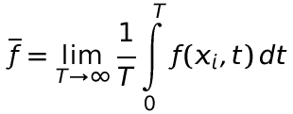
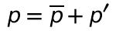
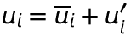
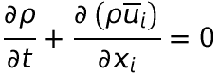
RANS Equations and the Closure Problem
The time-averaging is defined as
The instantaneous field is defined as the sum of the mean and the fluctuating component, such as
By averaging the Navier-Stokes equations, we obtain the Reynolds averaged Navier-Stokes (RANS) equations:
Reynolds stress tensor, R_{ij}

Slide 91
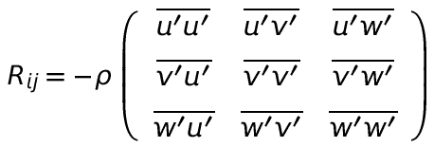
Reynolds Stress Tensor
R_{ij} is a symmetric, second-order tensor; it comes from averaging the convective acceleration term in the momentum equation
Reynolds stress thus provides the averaged effect of turbulent (randomly fluctuating) convection, which is highly diffusive
Reynolds stress tensor in the RANS equations represents a combination of mixing due to turbulent fluctuation and smoothing by averaging.

Slide 92
To obtain a reasonable accurate solution for wind turbine aerodynamics, three key elements are involved:
(1) A good mesh quality.
(2) An advanced turbulence model.
(3) An accurate solve scheme.

Slide 93
(1) A good mesh quality.
A large-enough flow domain is needed to avoid disturbances from the domain boundary surfaces, and a fine enough time step is preferable to generate a good result. However, a good match between mesh refinement, mesh quality, domain size and time step refinement is very important to produce a quality result, i.e. accurate solution and reasonable computation cost.

Slide 94
Mesh metric :
Aspect ratio
Skewness
Orthogonal quality

Slide 95
(2) An advanced turbulence model.

Slide 96
RANS Models Descriptions
Model | Description
Spalart – Allmaras | A single transport equation model solving directly for a modified turbulent viscosity. Designed specifically for aerospace applications involving wall-bounded flows on a fine near-wall mesh. Option to include strain rate in k production term improves predictions of vortical flows.
Standard k–ε | The baseline two-transport-equation model solving for k and ε. This is the default k–ε model. Coefficients are empirically derived; valid for fully turbulent flows only. Options to account for viscous heating, buoyancy, and compressibility are shared with other k–ε models.
RNG k–ε | A variant of the standard k–ε model. Equations and coefficients are analytically derived. Significant changes in the ε equation improves the ability to model highly strained flows. Additional options aid in predicting swirling and low Reynolds number flows.
Realizable k–ε | A variant of the standard k–ε model. Its “realizability” stems from changes that allow certain mathematical constraints to be obeyed which ultimately improves the performance of this model.
Standard k–ω | A two-transport-equation model solving for k and ω, the specific dissipation rate (ε / k) based on Wilcox (1998). This is the default k–ω model. Demonstrates superior performance for wall-bounded and low Reynolds number flows. Shows potential for predicting transition. Options account for transitional, free shear, and compressible flows.
SST k–ω | A variant of the standard k–ω model. Combines the original Wilcox model for use near walls and the standard k–ε model away from walls using a blending function. Also limits turbulent viscosity to guarantee that τ_{T} ~ k. The transition and shearing options are borrowed from standard k–ω. No option to include compressibility.
Reynolds Stress | Reynolds stresses are solved directly using transport equations, avoiding isotropic viscosity assumption of other models. Use for highly swirling flows. Quadratic pressure-strain option improves performance for many basic shear flows.

Slide 97
RANS Models Behavior Summary
Model | Behavior and Usage
Spalart – Allmaras | Economical for large meshes. Performs poorly for 3D flows, free shear flows, flows with strong separation. Suitable for mildly complex (quasi-2D) external/internal flows and boundary layer flows under pressure gradient (e.g. airfoils, wings, airplane fuselages, missiles, ship hulls).
Standard k–ε | Robust. Widely used despite the known limitations of the model. Performs poorly for complex flows involving severe pressure gradient, separation, strong streamline curvature. Suitable for initial iterations, initial screening of alternative designs, and parametric studies.
RNG k–ε | Suitable for complex shear flows involving rapid strain, moderate swirl, vortices, and locally transitional flows (e.g. boundary layer separation, massive separation, and vortex shedding behind bluff bodies, stall in wide-angle diffusers, room ventilation).
Realizable k–ε | Offers largely the same benefits and has similar applications as RNG. Possibly more accurate and easier to converge than RNG.
Standard k–ω | Superior performance for wall-bounded boundary layer, free shear, and low Reynolds number flows. Suitable for complex boundary layer flows under adverse pressure gradient and separation (external aerodynamics and turbomachinery). Can be used for transitional flows (though tends to predict early transition). Separation is typically predicted to be excessive and early.
SST k–ω | Offers similar benefits as standard k–ω. Dependency on wall distance makes this less suitable for free shear flows.
Reynolds Stress | Physically the most sound RANS model. Avoids isotropic eddy viscosity assumption. More CPU time and memory required. Tougher to converge due to close coupling of equations. Suitable for complex 3D flows with strong streamline curvature, strong swirl/rotation (e.g. curved duct, rotating flow passages, swirl combustors with very large inlet swirl, cyclones).

Slide 98
(3) An accurate solve scheme.

Slide 99
Y PLUS Adaption
The dimensionless cell wall distance Y PLUS should be below or at least approximated to 1.

Slide 100
The aerofoil behaviour of the wind turbine can be divided into three ﬂow domains, such as the attached ﬂow reign, the high lift/stall development reign and the ﬂat plate fully stalled reign .
As demonstrated by many researchers,all RANS models lack the ability to model stall at high wind speeds

Slide 101
Finite element method

Slide 102
Fluid structure interaction

Slide 103
Wind Turbine Gearbox

Slide 104
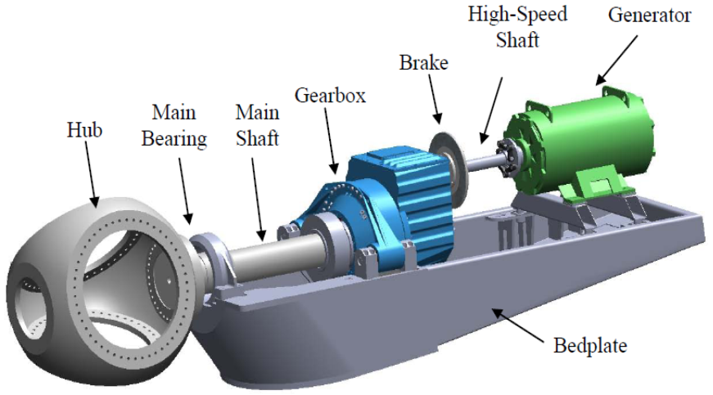
Gearbox
Gearboxes in wind power transform slow speed, high torque wind turbine rotation to higher speed required by the generator, which converts the mechanical power to electricity.

Slide 105
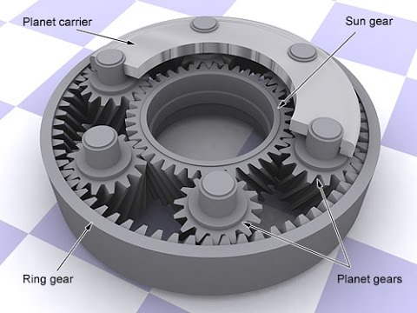
Gearbox Components
Gearbox used in a wind turbine is a planetary type, which has 3 main components:
The sun gear (central gear)
The planet gears and the planet gears' carrier
The ring gear

Slide 106
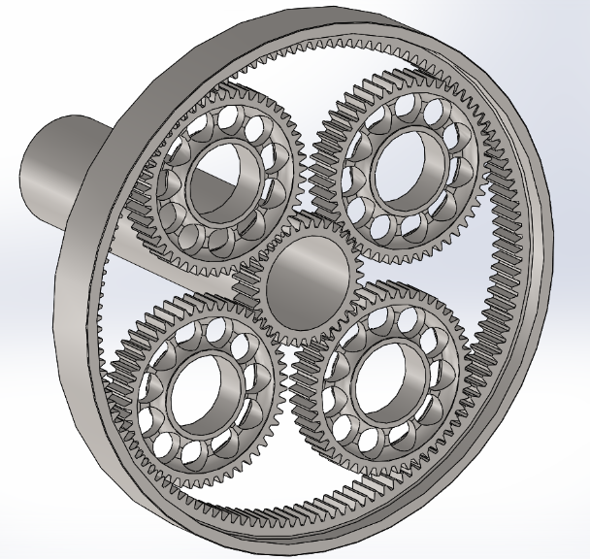
Gear Ratio Calculations
R: Number of teeth in ring gear
S: Number of teeth in sun (middle) gear
P: Number of teeth in planet gears
Constraints:
All teeth have the same pitch or tooth spacing (to ensure the teeth would mesh)
R = 2 × P + S

Slide 107
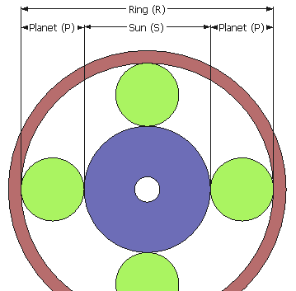
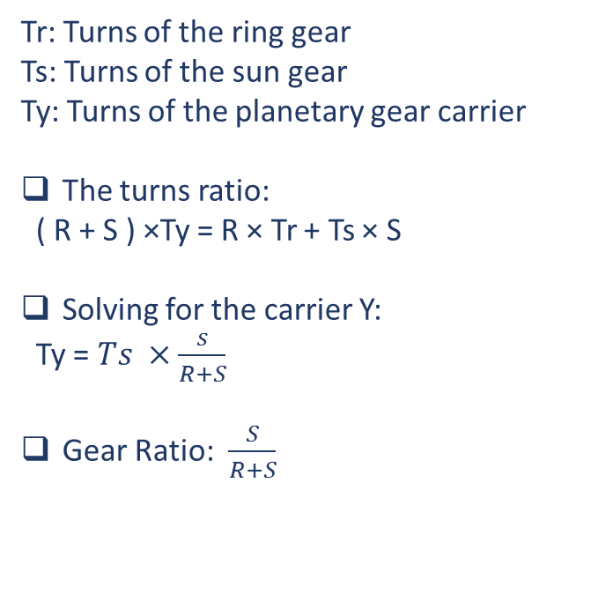
Gear Ratio Calculations
Tr: Turns of the ring gear
Ts: Turns of the sun gear
Ty: Turns of the planetary gear carrier
The turns ratio:
( R + S ) ×Ty = R × Tr + Ts × S
Solving for the carrier Y:
Ty = $Ts ×\frac{s}{R+S}$
Gear Ratio: $\frac{S}{R+S}$

Slide 108
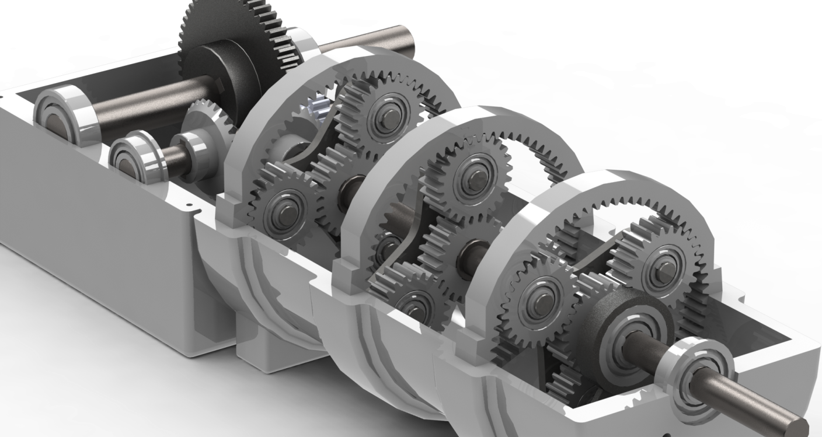
Planetary Gear Suppliers
The two major gearbox suppliers are German Winergy, which has about 50% of the world market, and Hansen of Belgium, with approximately 30% of the market.

Slide 109
Wind turbine
Selection of Generators

Slide 110
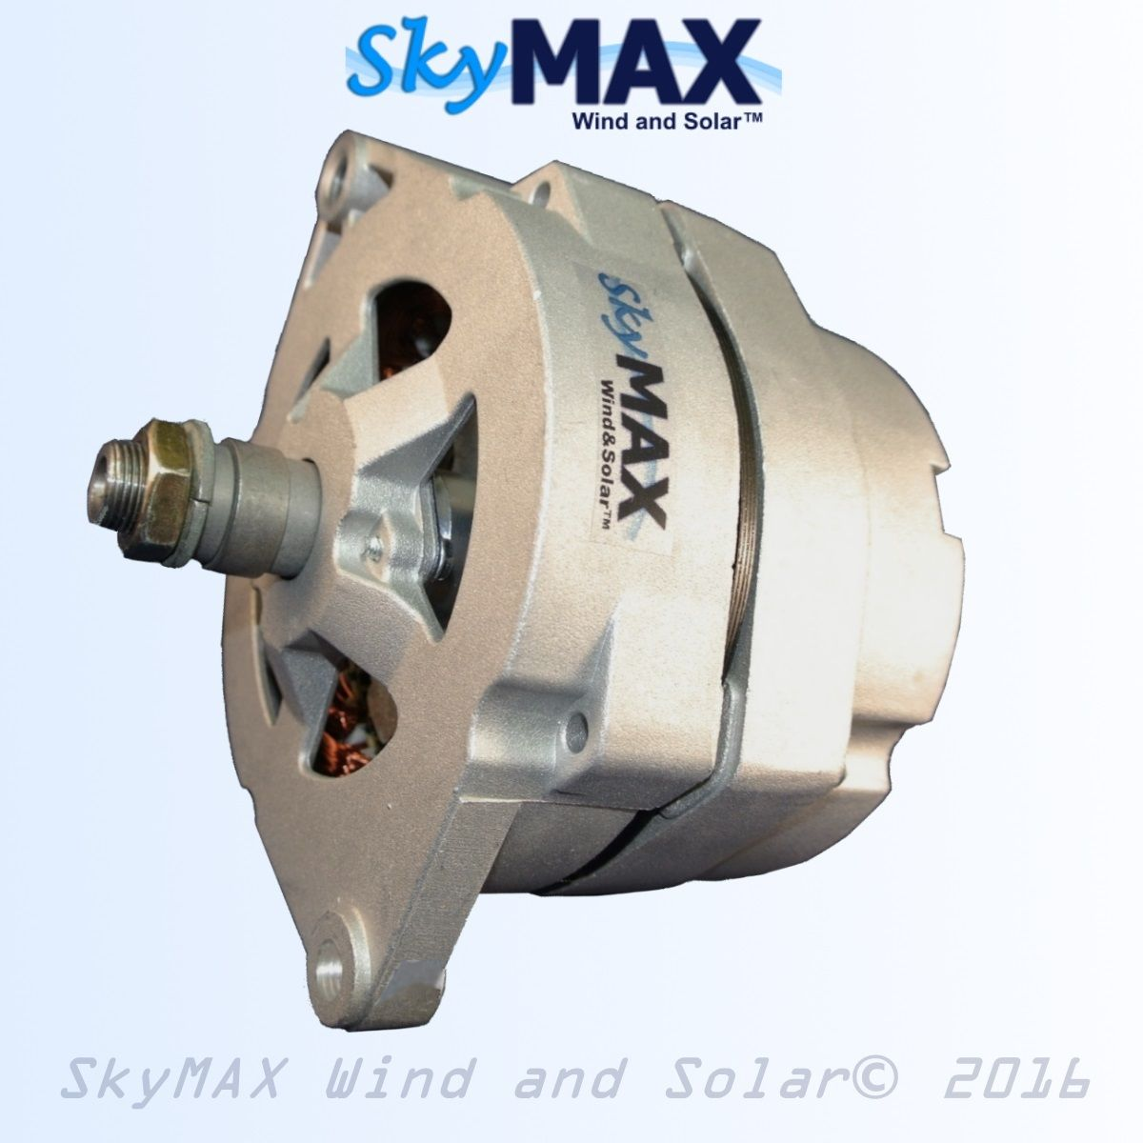
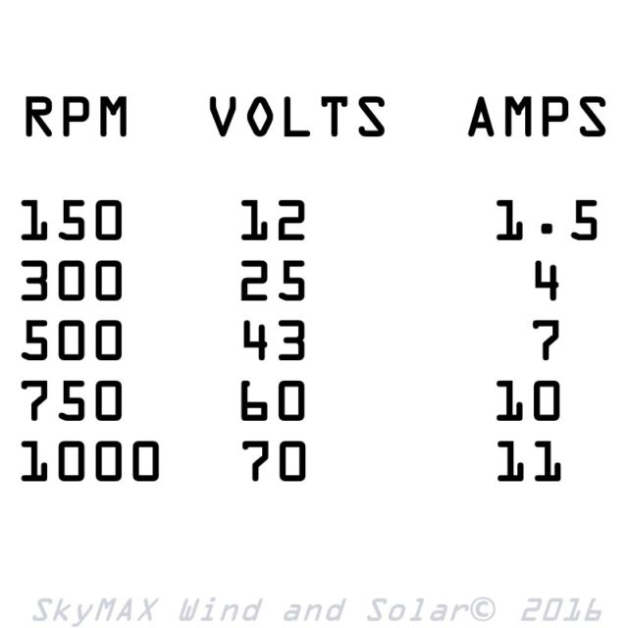
Small Scale Generators
1) Basic Permanent Magnet Alternator (US $119.58)
Features:
Uses Rare Earth Neodymium Magnets.
Hand Wound Stator Coils.
Ideal for low wind start-up.
Reaches over 12V BELOW 150RPM.

Slide 111
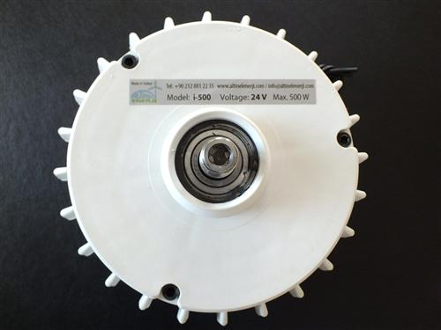
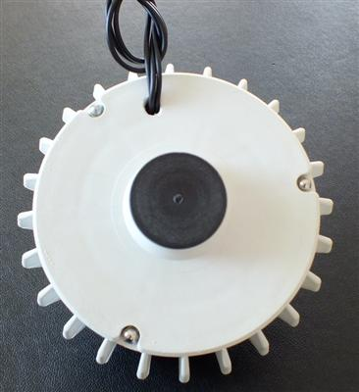
2) ISTA BREEZE Wind Generator (US $225.14)
Features:
Uses Rare Earth Neodymium Magnets.
Uses overspeed control “Electromagnetic brake with controller“.
Rated Voltage 24V.
Rated Power 400W.
Weight 2kg.
Made in Germany.

Slide 112
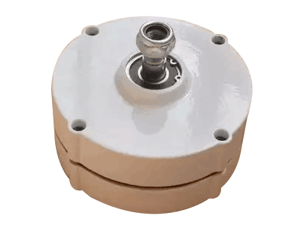
3) NdFeB Permanent Magnet Generator/Aluminum shell (US $234.59)
Features:
Uses Rare Earth Neodymium Magnets.
Rated Voltage 24V
Rated Power 500W
2.0m/s Low Speed Start
Made in China

Slide 113
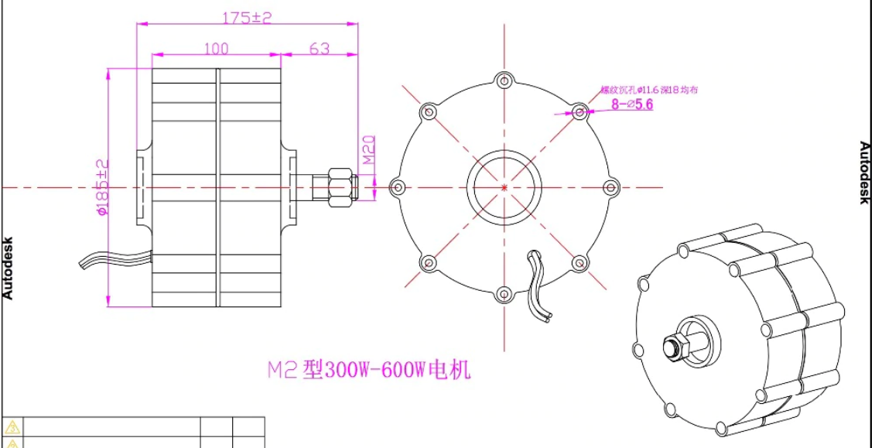

Slide 114
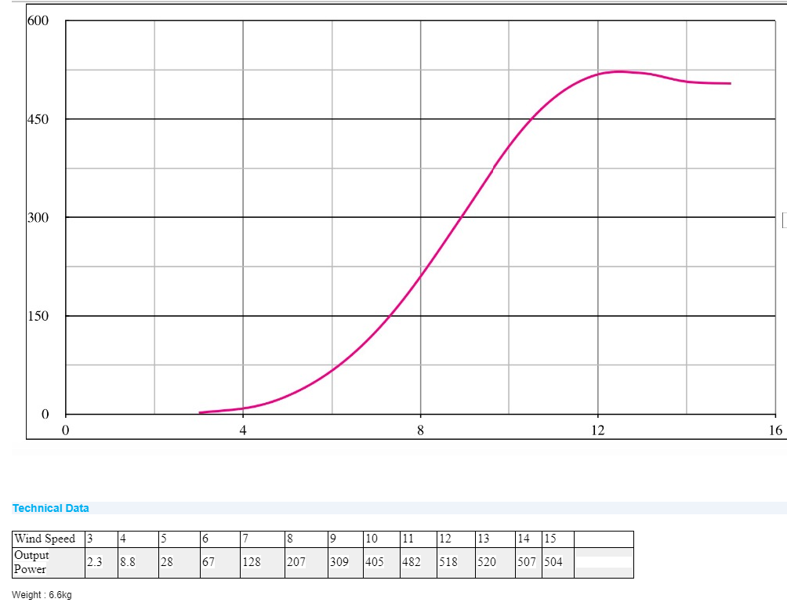

Slide 115
Wind Turbine Brakes
What Are Wind Turbine Brakes For?
Wind turbine brakes are important for
Maintenance
Emergencies
Protecting investment in the case of high wind speeds.
Main brake system types:
There are two major different types of wind turbine brakes:
Electrical Brakes
Mechanical Brakes

Slide 116
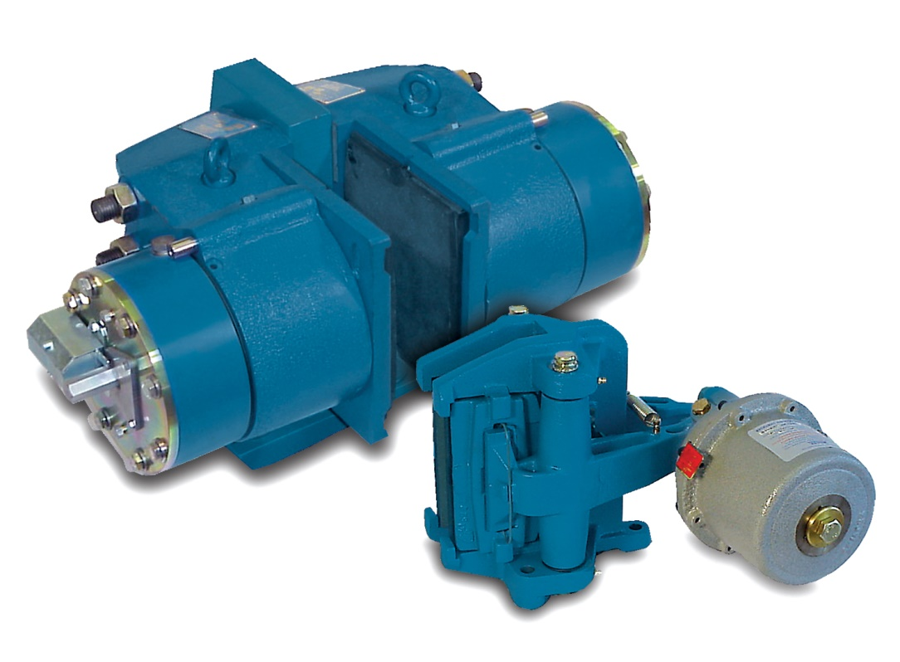
Types of brakes in wind turbine
Rotor Brakes
Yaw Brakes
Pitch braking
1- Main rotor braking systems
Rotor brakes control overspeed, and provide parking and emergency braking.
These brakes can be mounted on the rotor (low-speed shaft), or on the generator (high-speed shaft), and in some cases on both shafts.
The most cost-effective position is on the high-speed shaft between the gearbox and the generator.
A further consideration regarding brake position is the possibility of gear tooth damage.

Slide 117
Braking torque for rotor brakes
The maximum permissible braking torque on the rotor shaft is usually imposed by the blades, or their anchorage to the gearbox input shaft.
A minimum level of braking torque also exists, below which the variable nature of the frictional forces under different operating conditions could place the turbine rotors at risk. It is therefore important to allow an adequate window of safety, to ensure that the brakes will always operate effectively and under all climatic conditions.
Other factors affect the achievable friction level:
• Bedding and conditioning of the liners
• Dirt on the braking surfaces
• Condensation
• Rubbing speed and pressure
• Disc temperature
• Disc surface finish and hardness
• Wear debris on liner surfaces

Slide 118
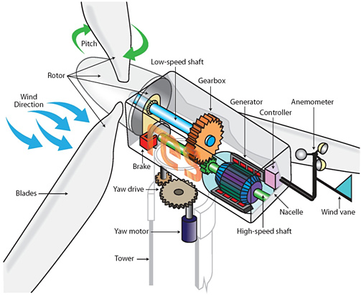
Types of rotor brakes for wind turbine:
ABS 75 FC
ABS 120 FC
ABT 75 G-R
ABT 90 G-R
ABT 75 S-R
ABT 90 S-R

Slide 119
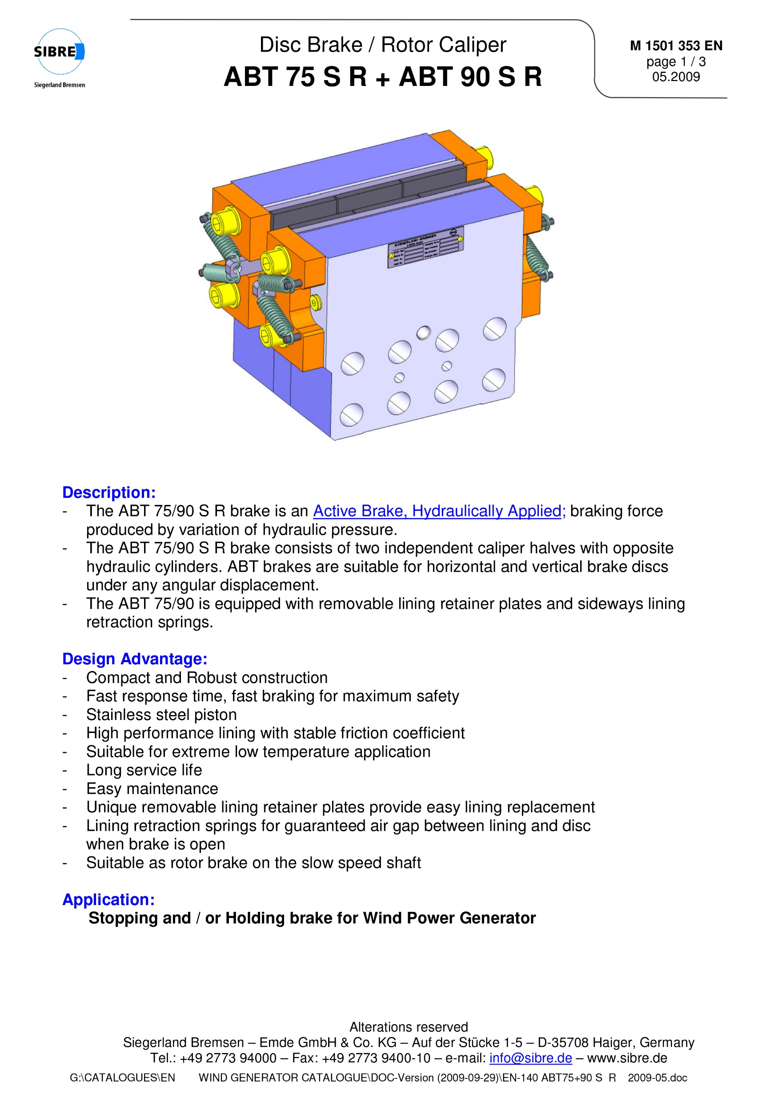
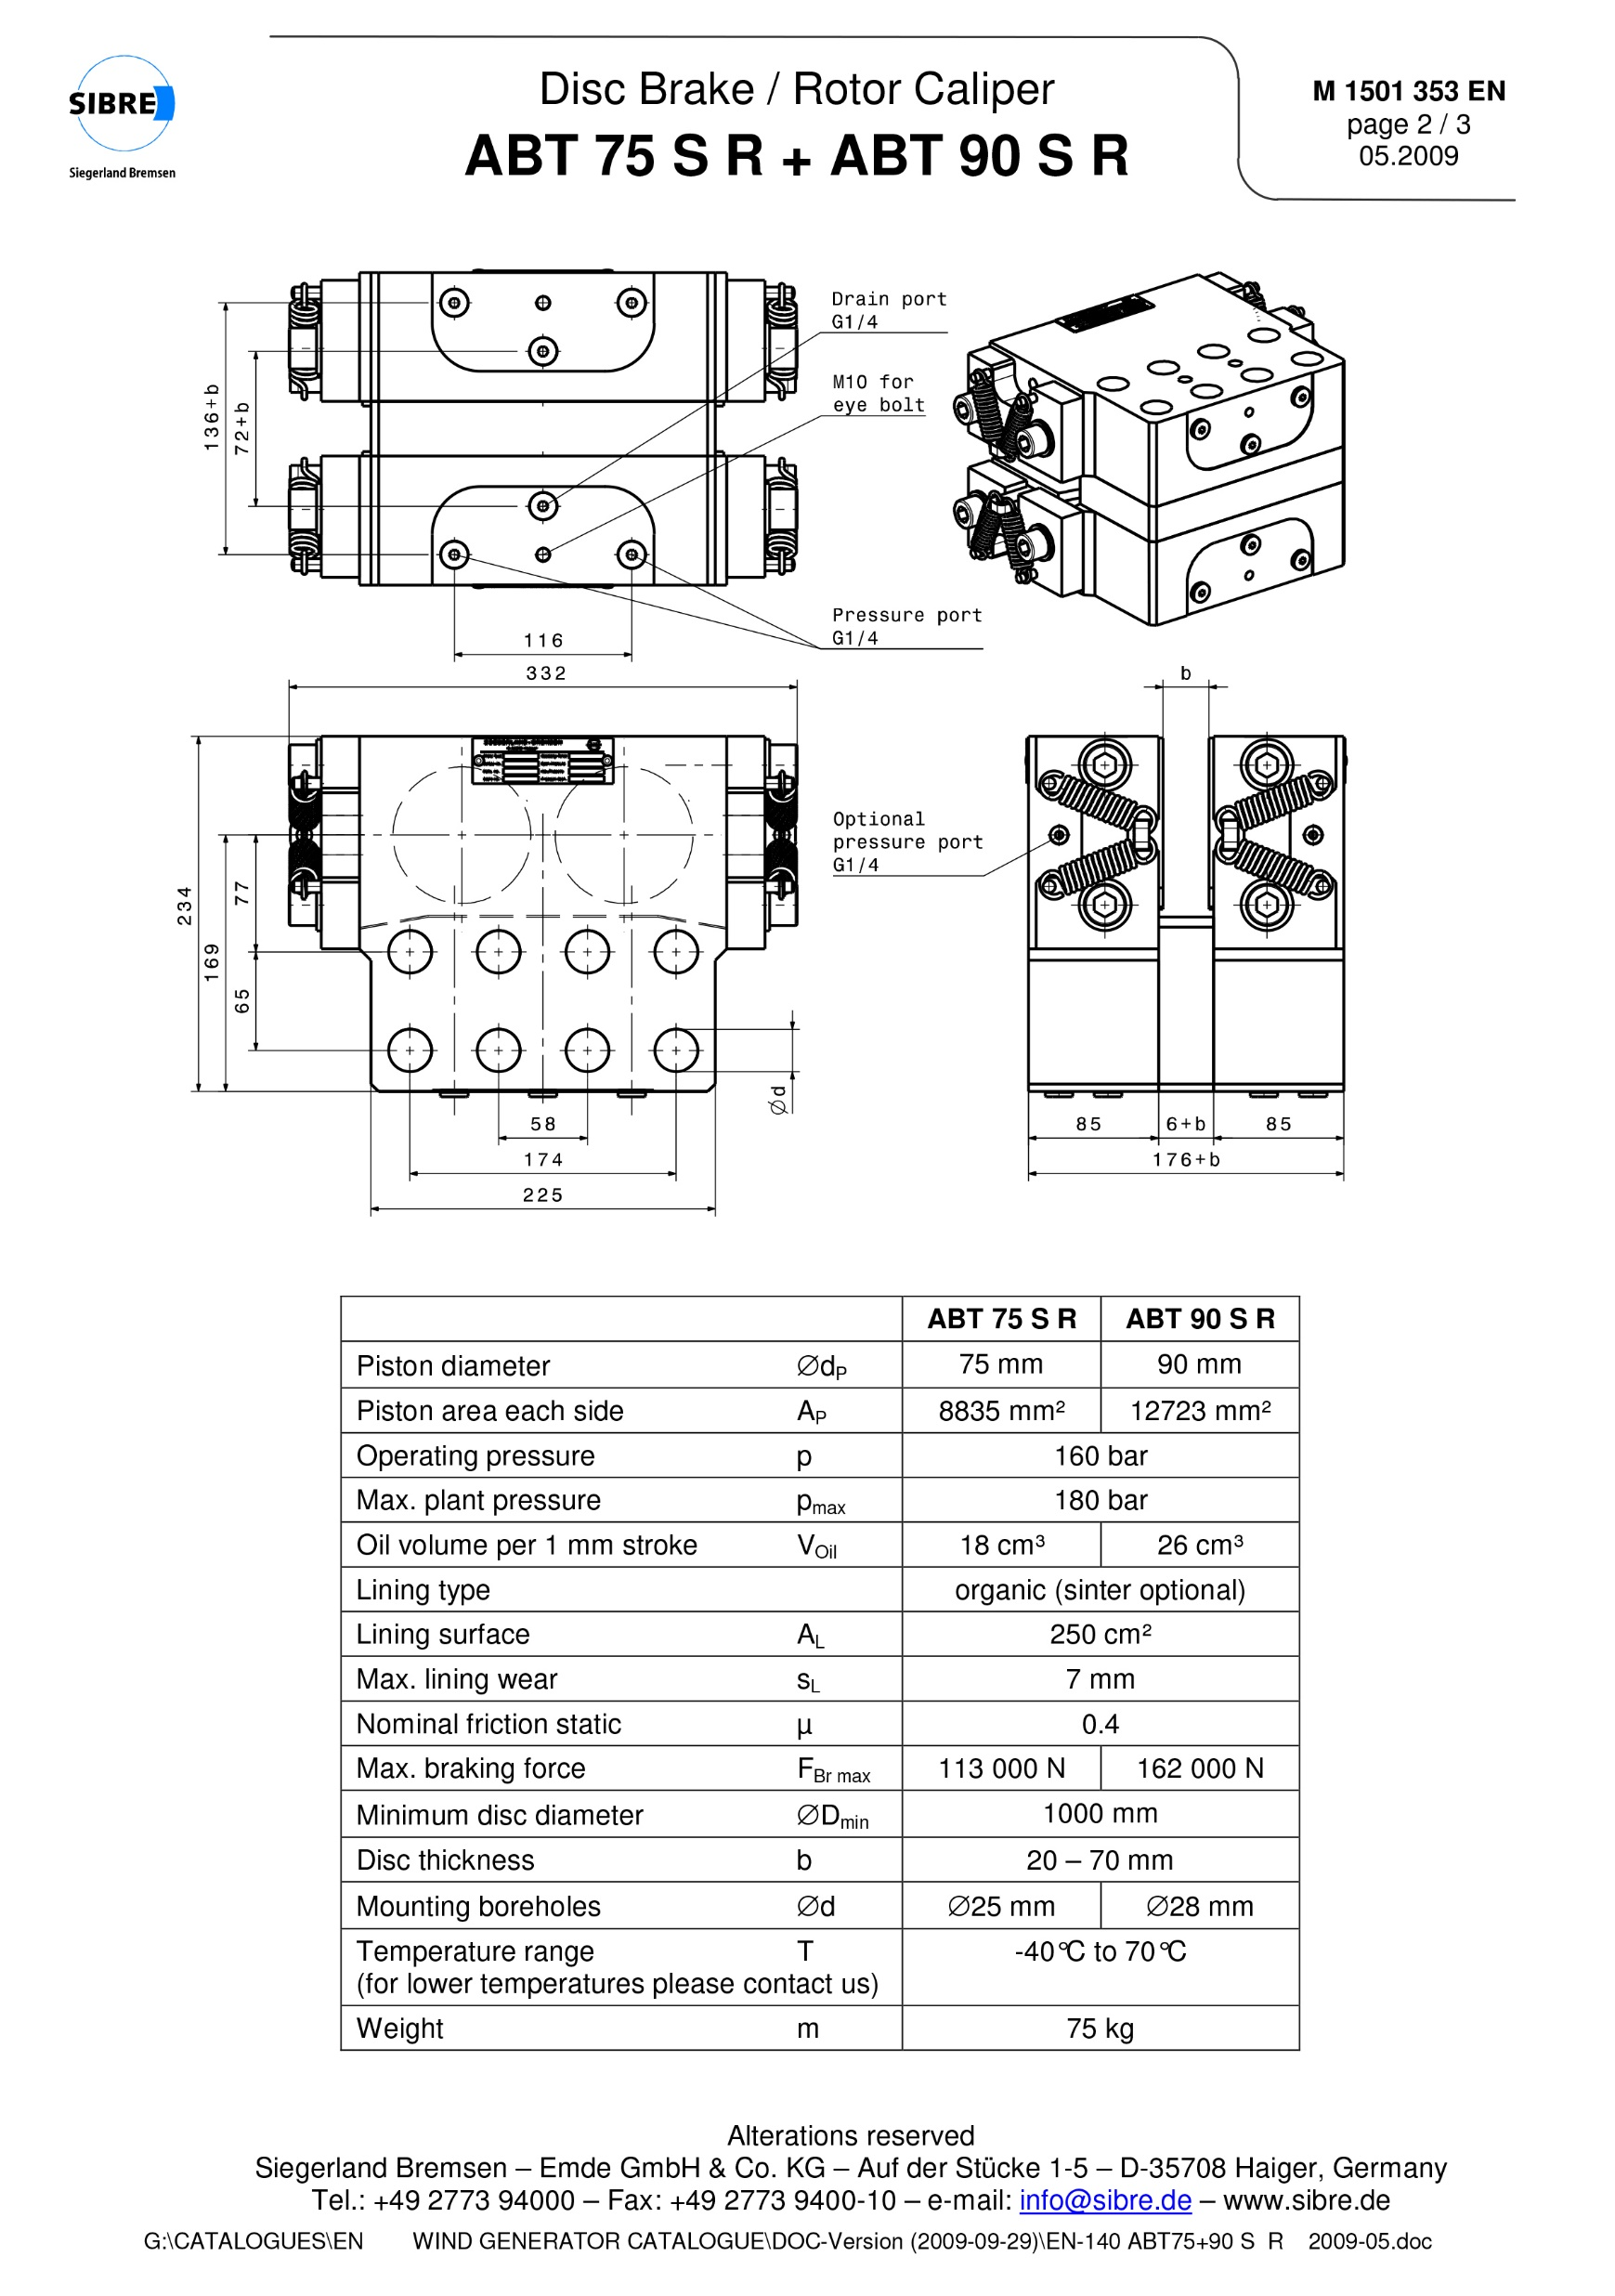

Slide 120
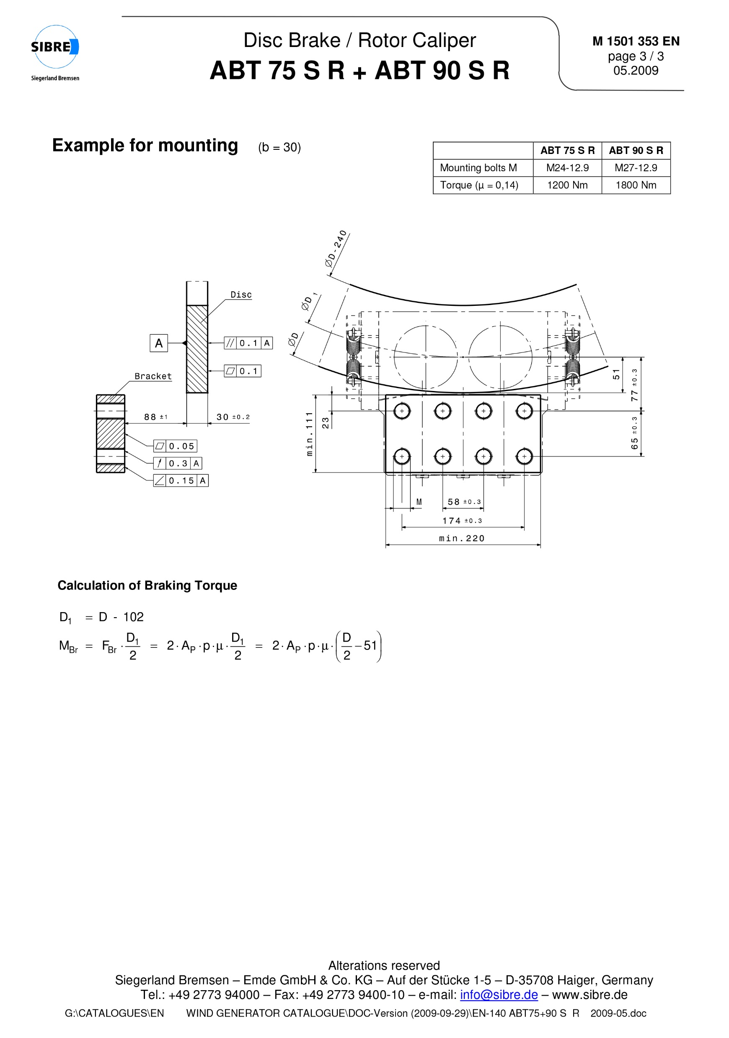

Slide 121
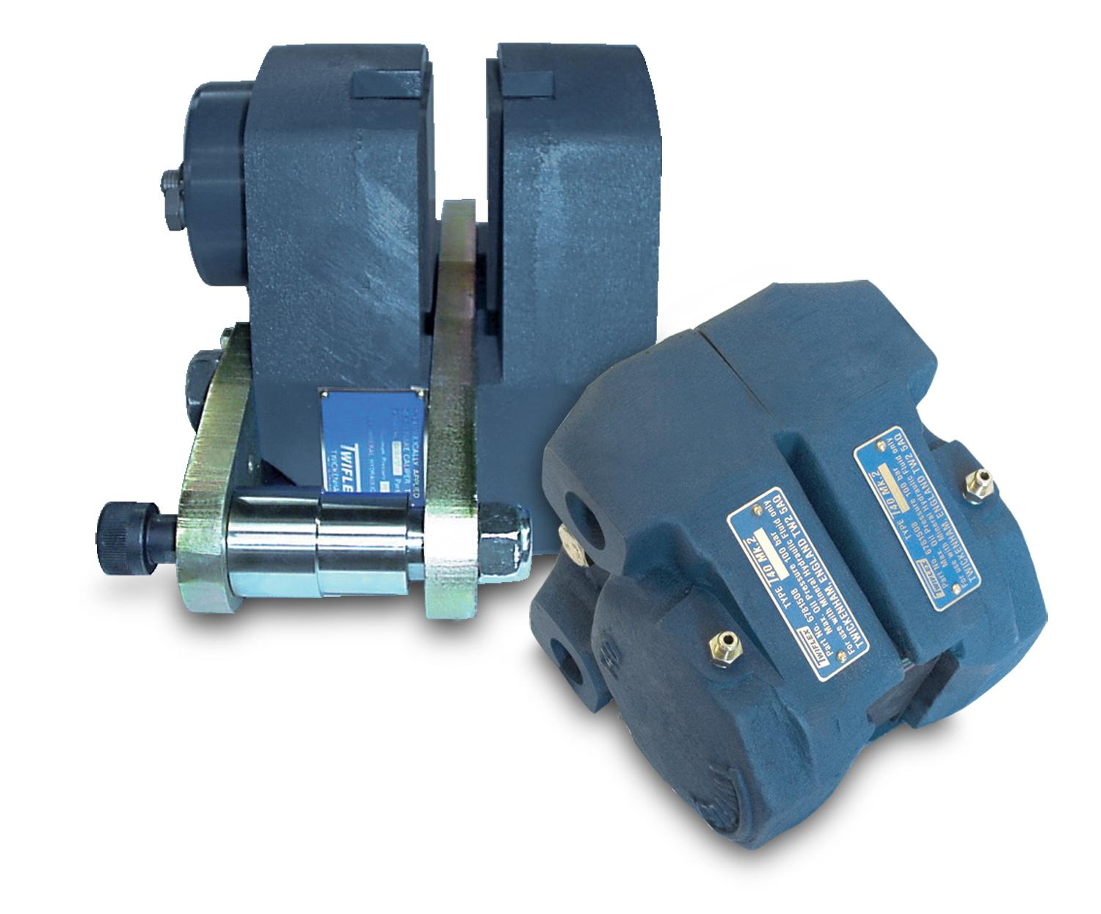
2. Brakes for yaw control
Yaw brakes provide an effective means of smoothly controlling a wind turbine nacelle as it rotates “up wind” or yaws. They are usually installed as drag brakes and operate by controlling back pressure, which in turn controls the degree of spring force and therefore braking torques.
An anemometer signals a change in wind direction which energizes the motor driving the gear ring on the yawing system.
Wind-turbine engineers agree that a mechanical disc brake is the best solution in terms of reliability, simplicity of manufacture, ease of servicing and initial cost.

Slide 122
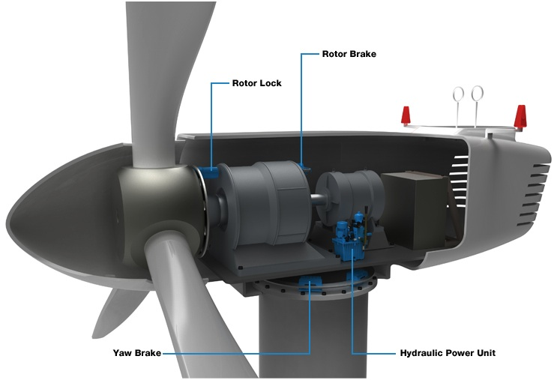
Types of yaw brakes for wind turbine:
ABT 75 G
ABT 90 G
ABT 75 S
ABT 90 S
ABT 120 G

Slide 123
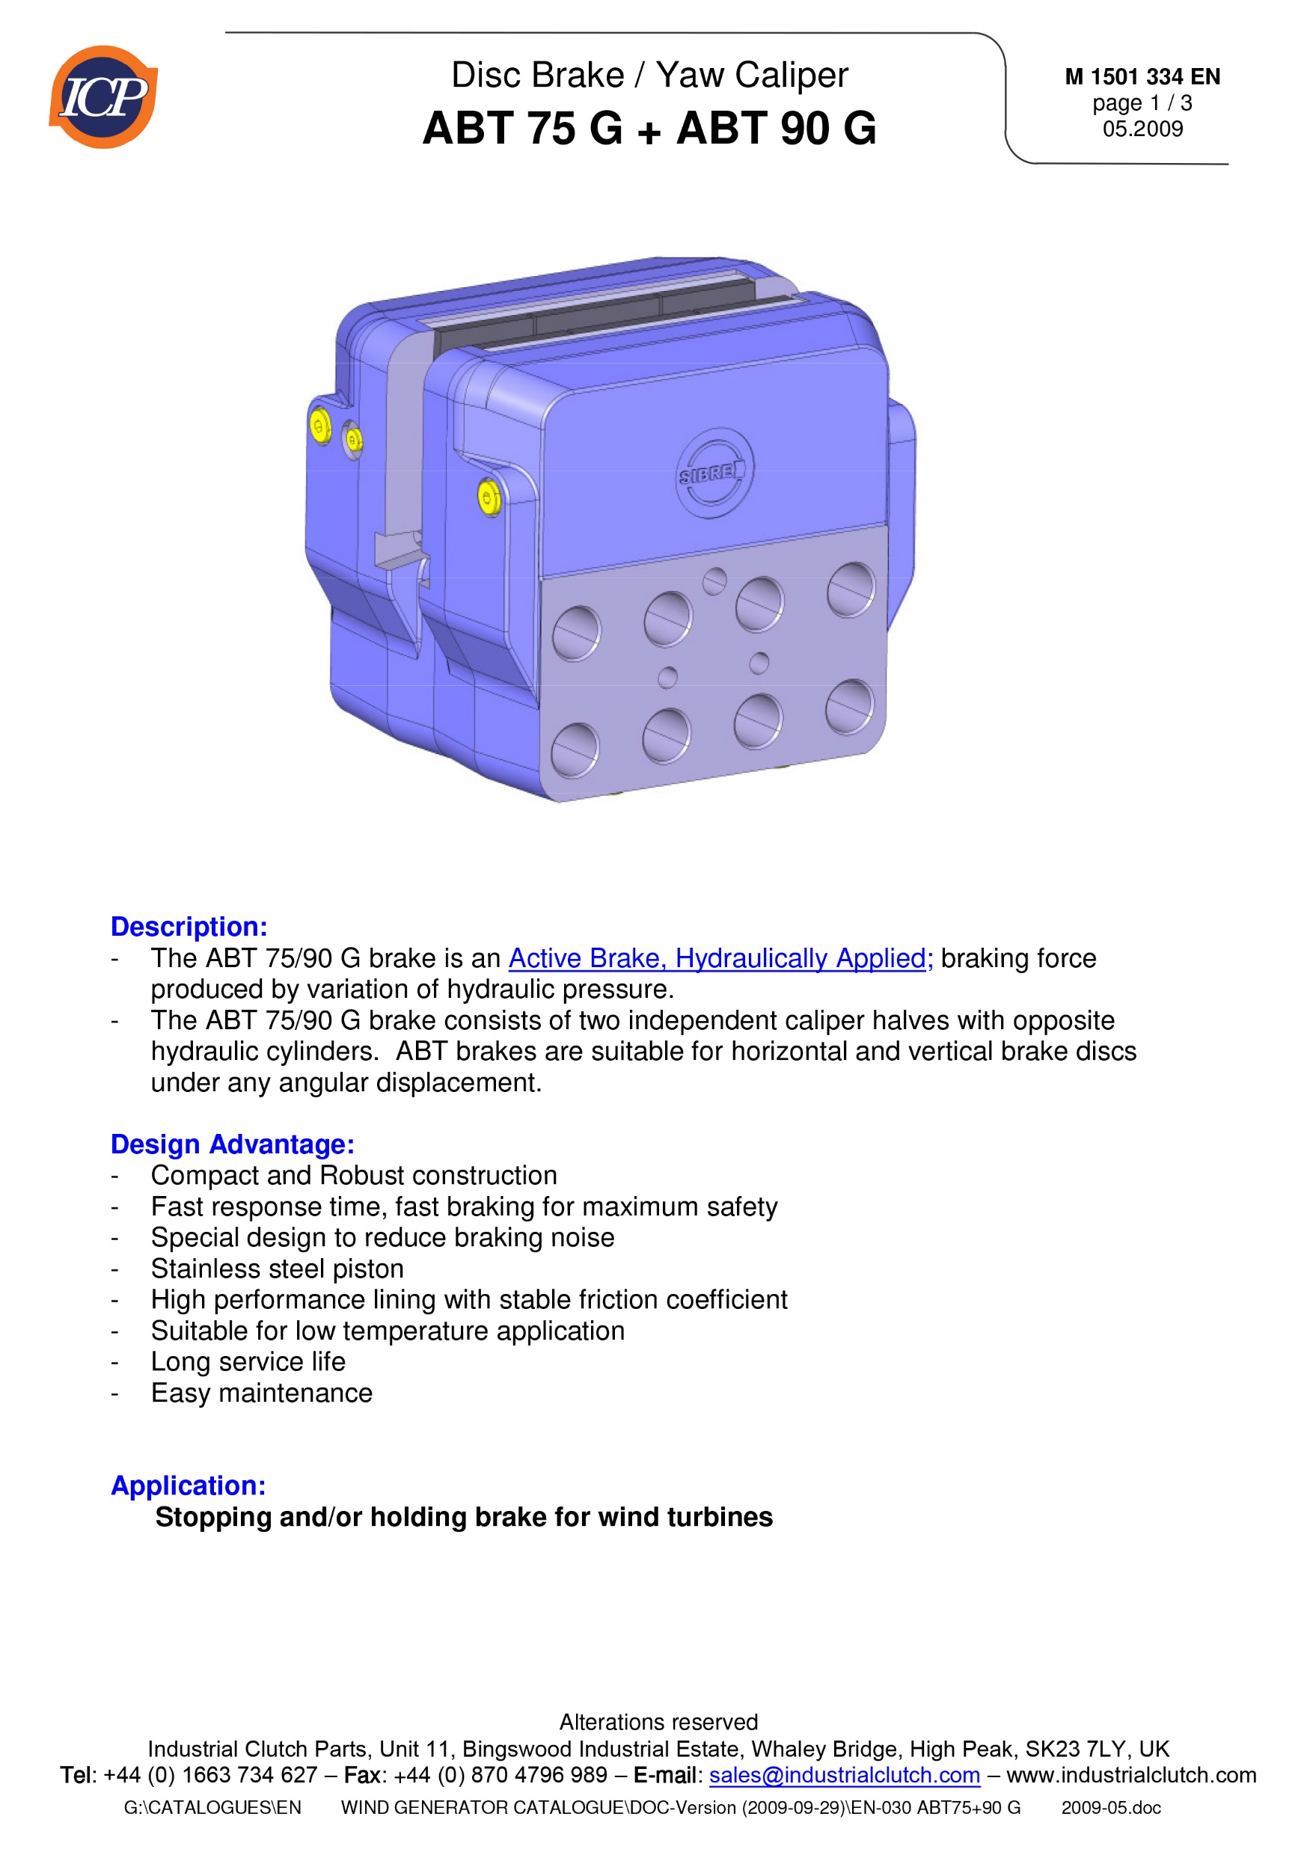
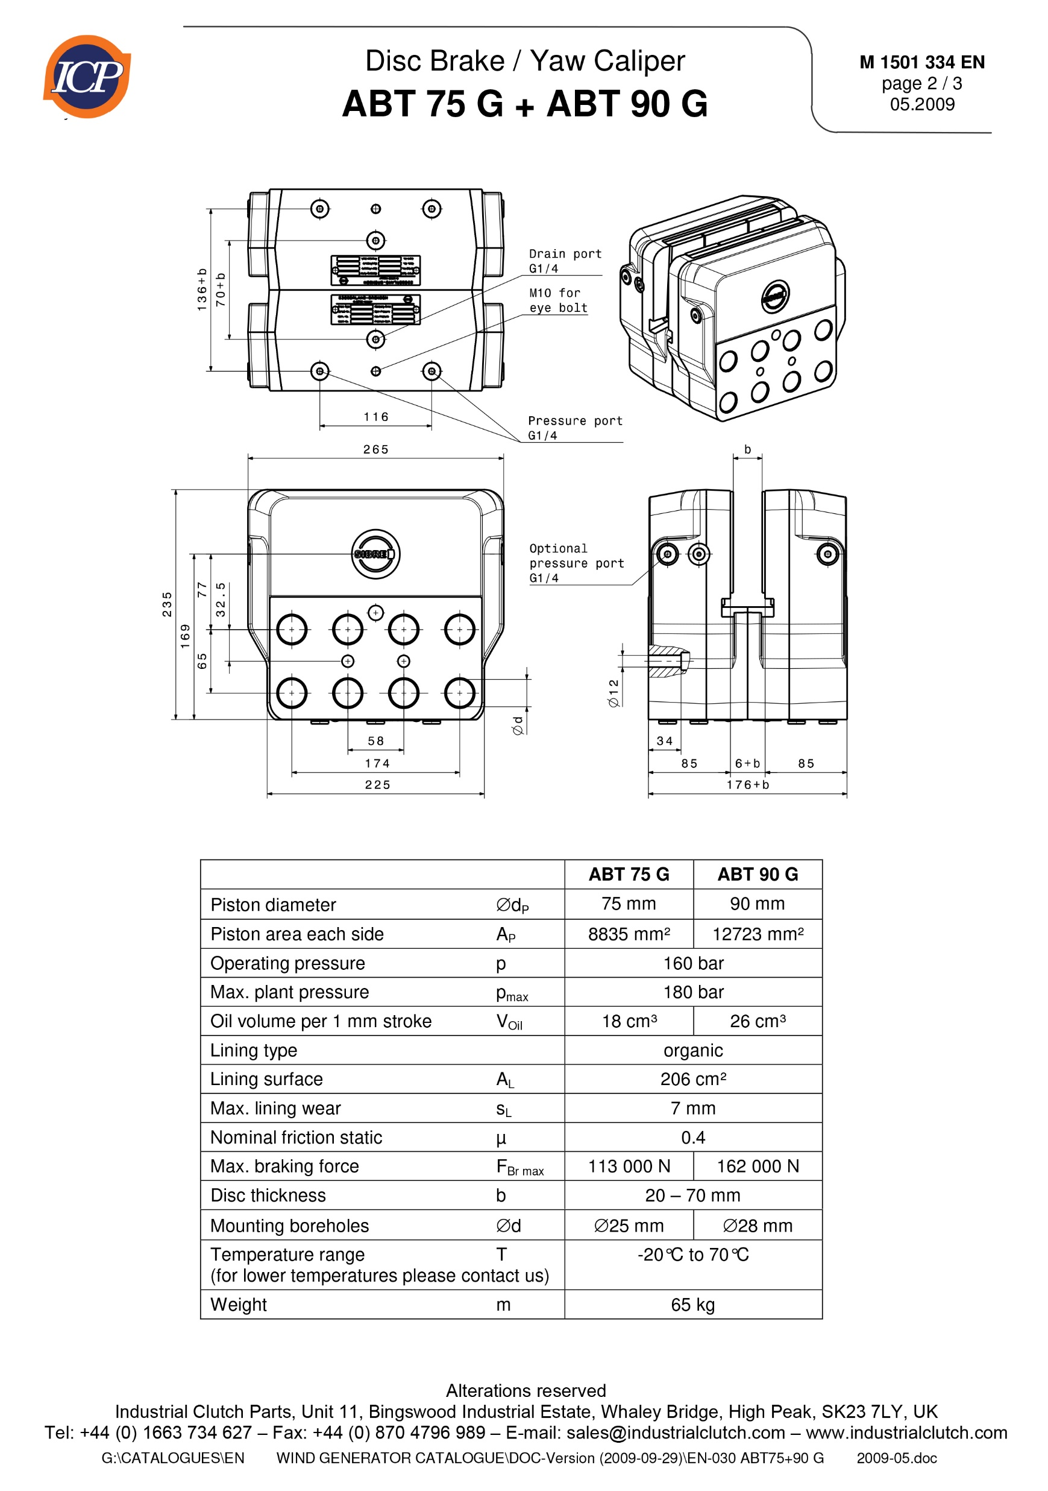

Slide 124
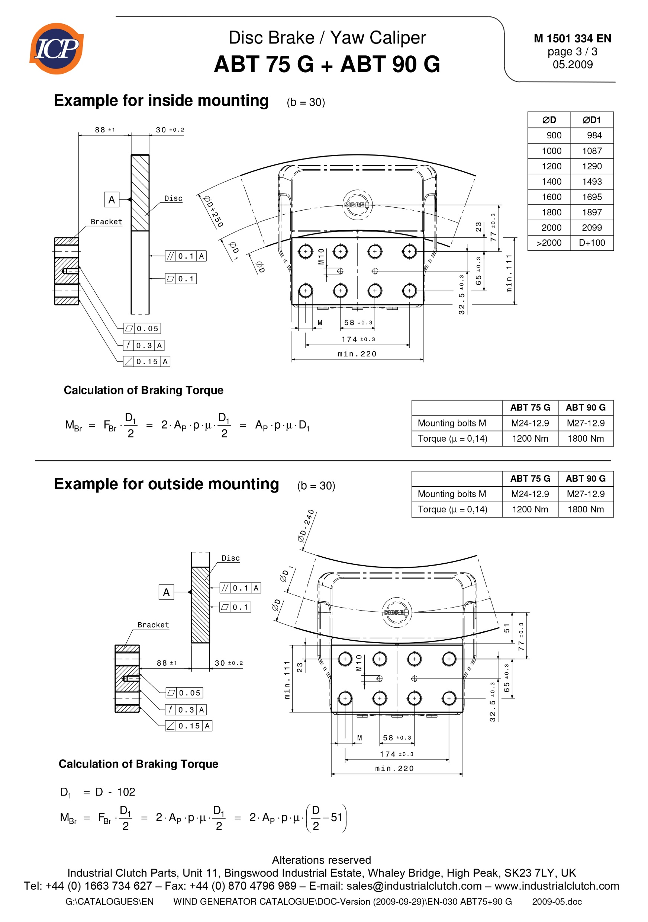

Slide 125
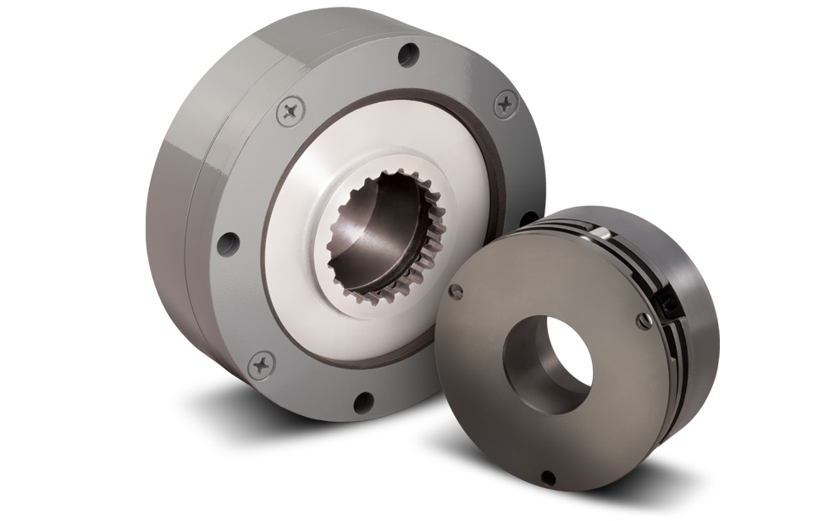
3. Blade pitch control braking considerations
Large horizontal axis wind turbines “pitch” or angle their rotor blades for best efficiency.
The rotor blades are also pitched or feathered to minimize rotation in high winds and for turbine maintenance.
Pitch drives can be driven electrically or hydraulically, but electrical is more common.

Slide 126
Optimization
Yaw Control System
Pitching Control System

Slide 127
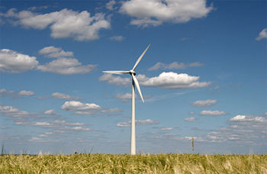
Wind turbine is a sophisticated system of component that must all work together to efficiently power production.
Like most sophisticated systems it can be divided into sections.
Some sections are dedicated to capture the wind energy, other sections convert the mechanical kinetic energy to electrical energy .
All of the sections depends on a control system to keep the turbine facing into the wind and turning at proper rate.

Slide 128
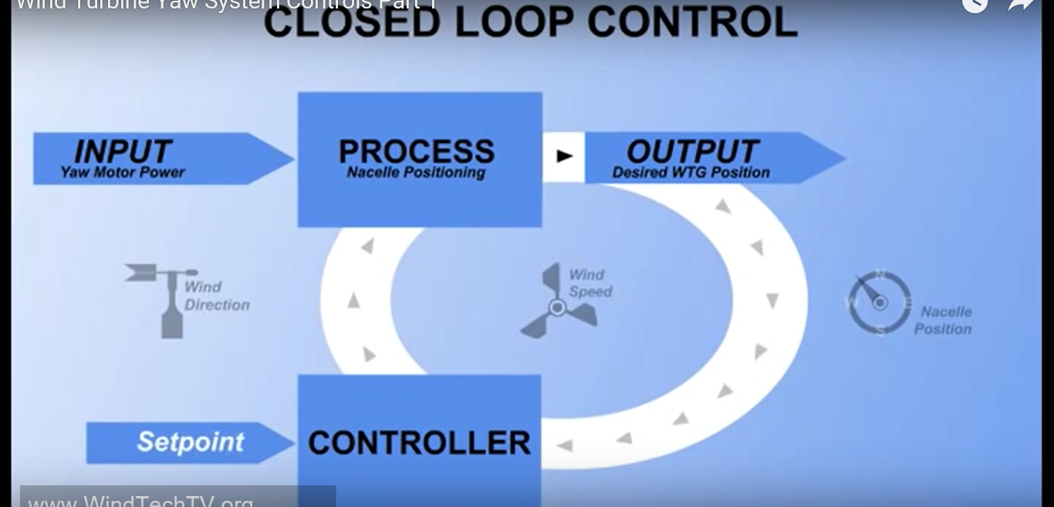
-closed loop control system
-The closed loop control system measure variables that affect system performance and compare this measurements to desired performance which is called (SETPOINT).

Slide 129
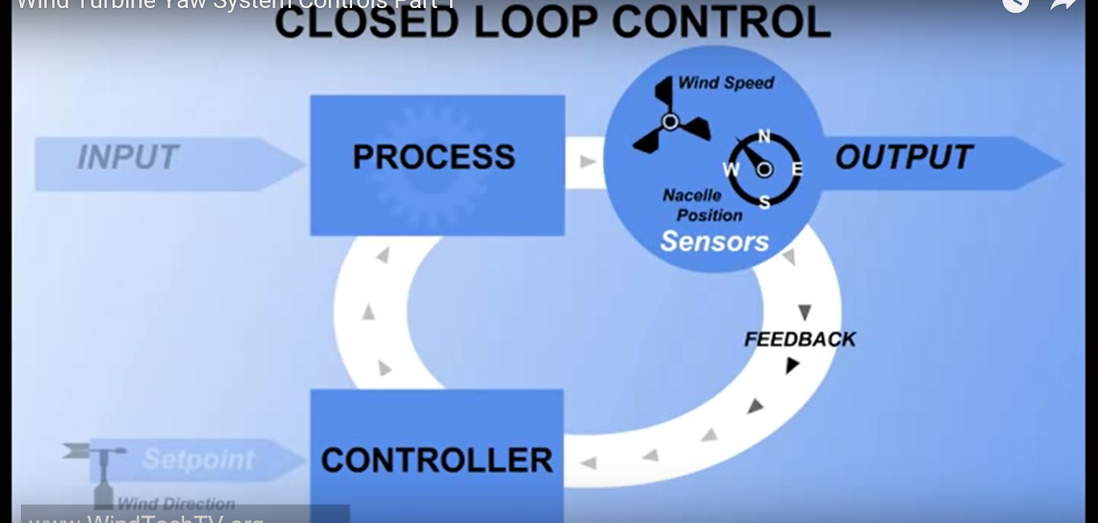
-Wind turbine yaw control system measures wind direction, wind speed and the current position of the turbine.
Measurements of these variables are made using sensors
Sensors is a device converts the physical quantities into an electrical signal such as volt, current or frequency that can be understood by the controller.
Information from the sensors is called feedback, feedback is used by the controller to make decisions and take actions to keep the wind system operating

Slide 130

An important control function is to keep the turbine pointed into wind, so a simple instruction might be, if the wind direction differ from the direction turbine is pointing by more than 5 degree then turn the nacelle until it is aligned.
In this case the turbine aligned with the SETPOINT, to maintain it the controller receives a signal from the wind directional vane and compare it to the nacelle position sensor, if the wind direction and nacelle position are the same no action required and everything remain constant.
When the wind direction change, then is a difference bet. The SETPOINT and error signal is produced, the error signal is used by the controller to produce a correction signal that will sent to the actuators in motion to move the nacelle to the SETPOINT.

Slide 131

2
(Actuators),Devices such as electric motors or hydraulic cylinders that create motion and can be controlled with an electrical signal.
The main reasons to use yaw control system
1-To point the nacelle into wind for power generation.
2-To detect cable twisting resulting from yaw activity and unwind the cables as necessary.
3-To turn the nacelle away from the wind (FURLING)
FURLING:- it used to protect the turbine from high wind or to stop hub rotating for shut down. (ONE OF THE BREAKS TYPE).

Slide 132

2-To detect cable twisting resulting from yaw activity and unwind the cables as necessary:-
As the nacelle tracks the wind the flexible power cables become twisted, but might untwisted as the wind changes direction.
Sensors detect nacelle rotation and the controller count the revolutions.
If the twist becomes excessive the controller will put the turbine into a stop state and rotate the nacelle to untwist the cables
If the nacelle is pointing 180 degree away from the wind, the controller will determine which direction will untwist the cable.
And then turn the nacelle in that direction to realign it with the wind.

Slide 133
3-To turn the nacelle away from the wind (FURLING)
it is used to protect the turbine from high wind or to stop hub rotation for shutdown
During normal operation when the wind speed is above 3 or 4 m/s the controller will keep the nacelle pointed into the wind and make corrections as the wind direction changes.
time of low or no wind it is not necessary to keep the nacelle pointing into the wind, in fact tracking the wind is too low to produce power results in unnecessary wear on the yaw system.

Slide 134

Sensors potentiometer, encodes, ultrasonic sensors may used to detect wind direction.
1-poteniometer:-
A variable resistor consisting of a resistive strip, three terminals and a movable wiper

Slide 135

The movable wind vane is connected to a wiper, as the wind direction changes the vane moves the wiper across the resistive element and the output of the potentiometer changes in proportion to the wind movement.
Adv.
1- provide excellent linearity
2-simplicity
3-low cost

Slide 136

Disadv.
1- wiper wear that requires periodic replacment.
2-Dead band gap as a wiper crosses from point A to point B

Slide 137

Encoders:-
-Consists of coated perforated disc, several light sources which an usually light emitting diodes and corresponding light detectors, a binary bit is produced when light passes through the disc and the detector is activated
-when each bit is grouped with bits from the other encoder tracks, absolute encoders can create many different binary position codes
-every code has a unique value that matches a position within the encoders 360 of rotation.

Slide 138

Wind direction detectors use disc constructed with special binary code called gray code
This special binary code used cause each change of position changes only one bit of the code
Gray code shown, the disc divides the nacelle 360 degree of rotation into 16 parts, each section represent 22.5 degree.

Slide 139


Ultrasonic anemometer:-
Uses sound wave to measure both wind direction and speed of wind
The time taken for an ultrasonic pulse to travel from one transducer to another
And then compares it with the time taken for another pulse to travel in the opposite direction

Slide 140
Yaw position sensors:-
To keep the turbine positioned into the wind the controller compares the wind direction to the direction of the nacelle
The yaw position sensors send this directional information to the controller
1-encoders
2-limit switches
3-proximity sensors

Slide 141

Incremental encoders:-
Similar to absolute encoders, except that instead of many light sources and detectors it only needs one or two.
By counting the no. of pulses produced the controller may calculate how far the nacelle ha yawned, may measure the distance of travel but not the direction of travel
To measure the direction another light source is added to encoders with offset
By monitoring which sensor turn on first the controller can determine the yaw clockwise or counter clockwise .

Slide 142


-The encoder is meshed with the yaw gear

Slide 143


Limit Switches:-
It has the same idea of the encoders but without binary codes
The limit switches is connected to a cam shaft and this cam shaft push the switch and produce a signal

Slide 144


Proximity sensors (PROX sensor):-
They detect metallic targets such as cams, gear tooth
Inductive prox sensors designed to emit an oscillating magnetic field
When the metallic target enters the field the target absorb some of the field energy and the oscillation stop
This action triggers a switching circuit connected to the controller when the target is sensed the controller receive a signal that the target is placed.

Slide 145


Slide 146

Pitching system

Slide 147

The pitch mechanism in large wind turbines enables the rotation of the blades on their longitudinal axis. It can change the angle of attack of the blades with respect to the wind, by which the aerodynamic characteristics of the blade can be adjusted.
This provides a degree of control over the captured power to improve conversion efficiency or to protect the turbine.
When the wind speed is at or below its rated value, the angle of attack of the blades is kept at an optimal value, at which the turbine can capture the maximum power available from the wind.

Slide 148
When the wind speed exceeds the rated value, the pitch mechanism is activated to regulate and limit the output power, thus keeping the power output within the designed capability.
For this purpose, a pitch range of around 20 to 25 degrees is usually sufficient.
When the wind speed increases further and reaches the limit of the turbine, the blades are completely pitched out of the wind (fully pitched or feathering), and no power will be captured by the blades. The wind turbine is then shut down and protected

Slide 149


The pitch mechanism can be either hydraulic or electric. Electric pitch actuators are more common nowadays since they are simpler and require less maintenance.
Traditionally, all blades on the rotor hub are pitched simultaneously by one pitch mechanism. Modern wind turbines are often designed to pitch each blade individually, allowing an independent control of the blades and offering more flexibility.

Slide 150
Thanks ☺

